Slide 1
Basic Departmental
Internal Controls
Office of Internal Audit
2020

Slide 2

Objectives
The purpose of this training is to inform and encourage employees as to what basic controls are needed within a department.
As an added bonus we will show you what we look for during a Basic Control Assessment (BCA)!

Slide 3
Internal Controls

Slide 4
Internal Controls
Internal controls - processes that provide reasonable (not absolute) assurance that particular objectives are achieved.
Control activities include a range of activities such as:
Approvals
Authorizations
Verifications
Reconciliations
Security of assets
Segregation of duties
We use internal controls for the following purposes:
Protect MSU/State of MS assets
Ensure records are accurate
Promote operational effectiveness and efficiency
Encourage adherence to policies
Ensure compliance with laws, regulations, and contracts

Slide 5
Types of Internal Controls
Control activities are actions supported by policies and procedures to manage risk.
PREVENTATIVE
Proactive controls to prevent loss
Designed to discourage errors or prevent irregularities from occurring
DETECTIVE
Provide evidence a loss has occurred
Designed to find errors/irregularities after they have occurred
Examples:
Segregation of Duties
Transaction Approvals
Adequate Documentation
Physical Control over Assets
Examples:
Reviews
Reconciliations
Physical Inventories
Analyses or Variance Analyses

Slide 6
Responsibility
University
Administration
University
Employees
University
Internal Audit
Responsible for promoting and maintaining a rigorous environment in which strong internal controls are mandated and monitored. They have a legal and ethical obligation to adequately support fraud prevention and detection efforts, including the development of strong fraud and conflict of interest policies.
Responsible for upholding its values and ethics in their actions. They should examine internal controls in their own operations and work with their supervisors to strengthen weak controls. They are obligated to report any suspicion or knowledge of unethical or fraudulent actions to the University's Office of Internal Audit.
Responsible for appraising the adequacy and effectiveness of internal controls. We evaluate whether controls provide reasonable assurance objectives are being met. We also investigate reported fraud and actively search for fraud during audit engagements.

Slide 7
Recommendations
Ensure state assets are used for state business
Set a strong example for the expectation of ethical behavior, compliance with laws/policies, and communicate your expectations routinely
Limit signature authority and don’t let anyone sign your name (an employee should sign their own name); never use a signature stamp
Be familiar with state policies and procedures; be willing to call and ask questions
Consider unique risks your unit may have (ex: cash collections, contracts, grants, etc.) and ensure additional oversight is provided
Ensure accounts are reconciled monthly and review reconciliations for any unusual transactions (this should include a review of payroll and leave reports)
Don’t let one employee have complete control of any process

Slide 8
Basic Control Assessment
(BCA) https://m.youtube.com/watch?v=ubNF9QNEQLA

Slide 9
BCA Areas
Account Reconciliations
Leave
Records of Hours Worked
Compensatory Time Balances
Cash
Procurement Card
Property Management
Fleet Management
Facilities Management
Sponsored Research
Information Security
Travel
General Administration
Management Review: 16%
Internal Audit: 14%
Tip: 42%

Slide 10
Account Reconciliations
University Policy:
61.01, Account Reconciliation
What we look at:
Ledger Report(s) FWREXEG or FWREXDP (grant accts)
What we look for:
Ledger reports are signed and dated by both the reconciler and DH (or the PI for grant accts)
Reconciliations are performed timely (monthly)
Reconciliations should be performed timely for all active accounts
Methods of reconciliation will vary depending on the size of the department and number of active accounts
Reviews of account reconciliation should be performed by the Department Head (DH) or Principal Investigator (PI) to ensure accuracy
Reconciliations should be supported by a detailed Banner Ledger Report (FWREXEG or FWREXDP)
  Treat the ledger report like a bank statement
  Look for strange transactions or unknown vendors
  Periodically ask about vendors and request the invoice (PayPal, Amazon, etc.)

Slide 11
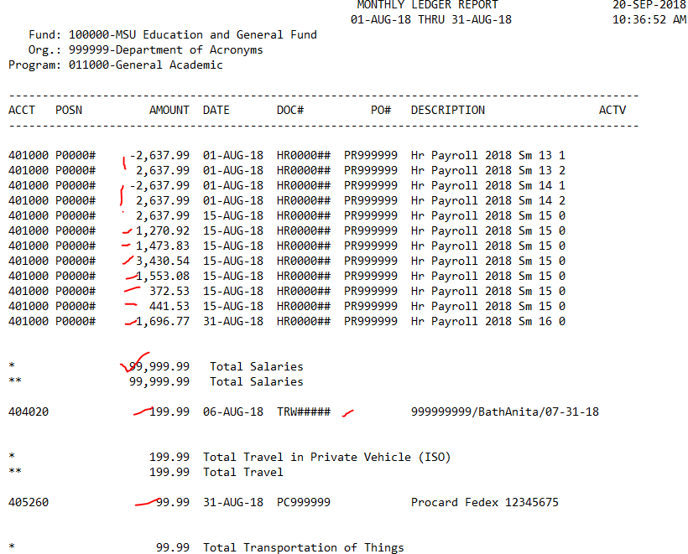
FWREXEG: Monthly Ledger Report
Evidence of Performance
Timely

Slide 12
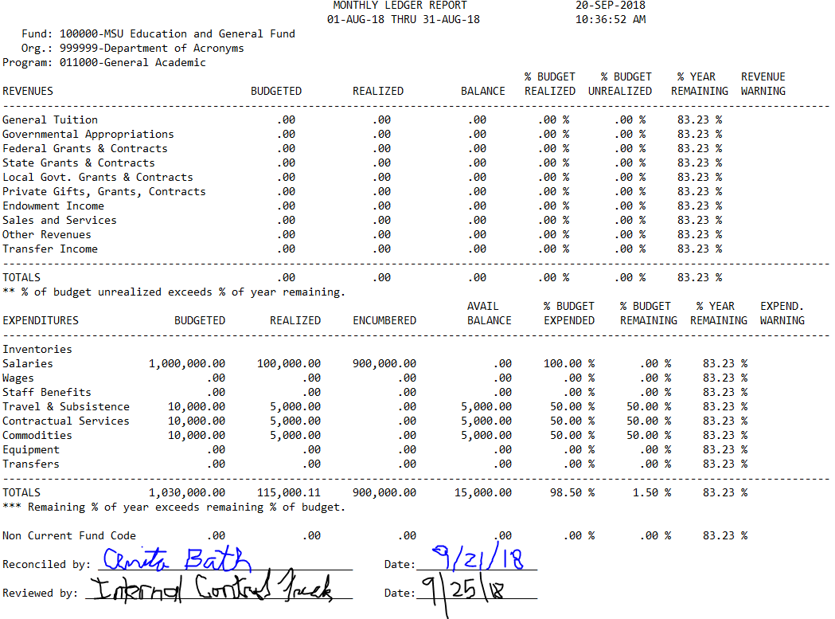
FWREXEG: Monthly Ledger Report
Signed by reconciler
Signed by reviewer (Dept. Head or PI for grants)
Timely

Slide 13
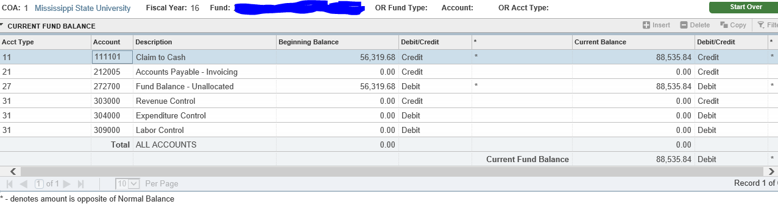
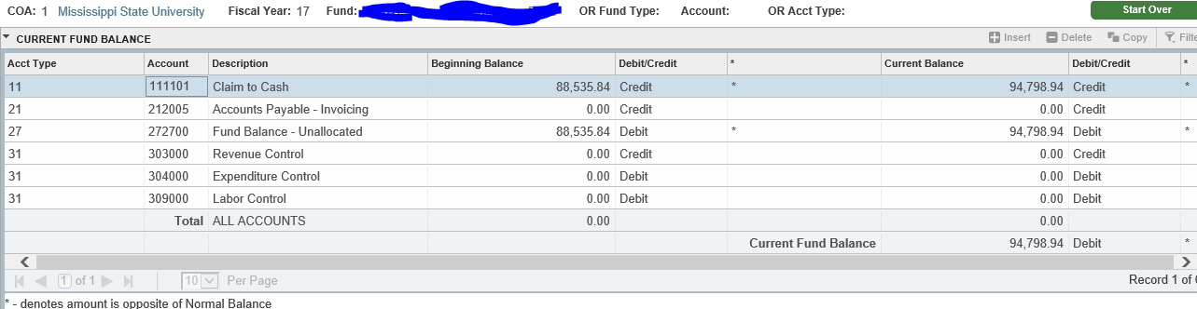
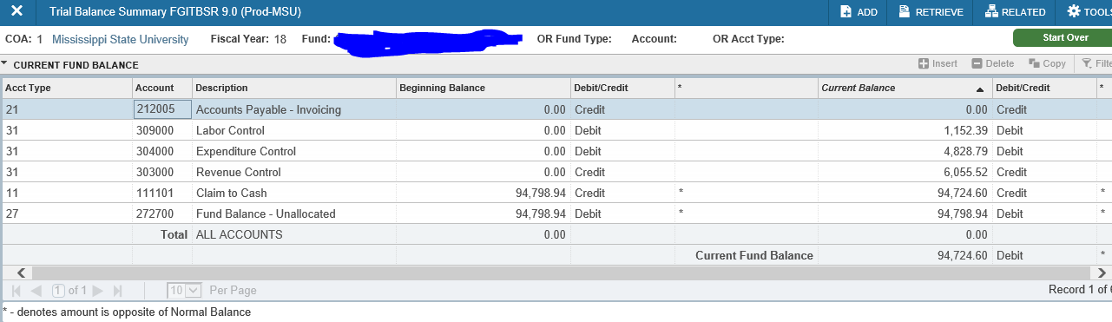
FGITBSR or Ledger Report
Changes in Fund Balance
Accounts with significant deficits
Accounts with negative change without expectation of relief
Note: Departmental account fund balances appear adequately provided for without significant deficits

Slide 14
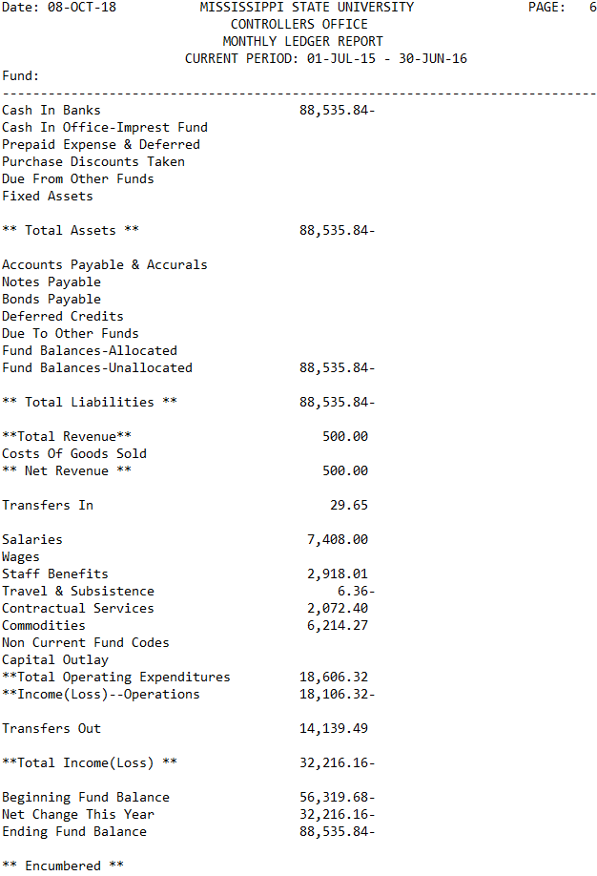
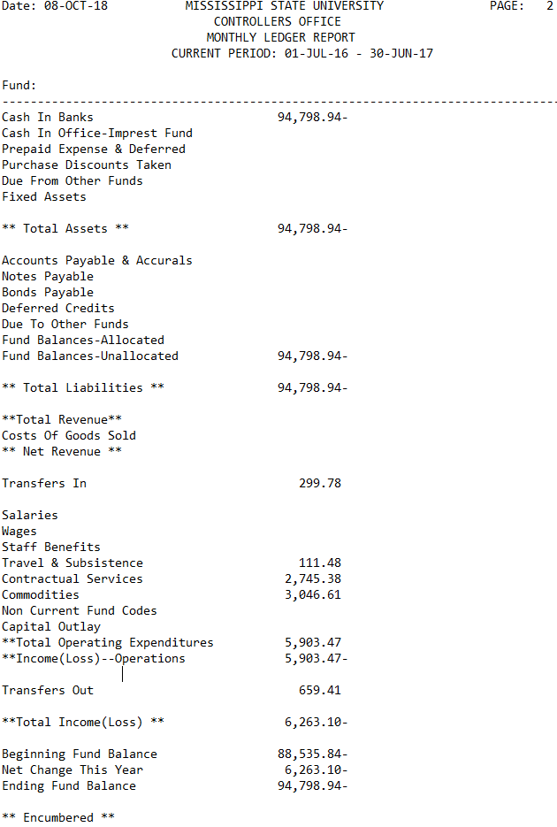
Ledger Report or FGITBSR
Changes in Fund Balance
Accounts with significant deficits
Accounts with negative change without expectation of relief
Note: Departmental account fund balances appear adequately provided for without significant deficits

Slide 15
Leave/Work Schedule
University Policy:
60.201, Leave/Leave Without Pay
Miss. Code Ann. § 25-1-98
60.320, Office Hours/Work Schedule
60.225, Tuition Remission
Office Hours Work Schedule
Miss. Code Ann. § 25-1-98 – …”construction of “workday”
  …all state offices shall be open and staffed for the normal conduct of business from 8:00 a.m. until 5:00 p.m., Monday through Friday”
  “A workday for a state employee in a full-time employment position … (8) hours in duration… shall develop work schedules which ensure … full-time employee works a full workday …provide the State Auditor with a copy of the regular work schedule…
Policy 60.320 – Work Schedules
  …determined by the department/unit head. ”
  Flexible work schedules may be adopted by the department/unit head to accommodate departmental needs

Slide 16
Leave/Work Schedule
University Policy:
60.201, Leave/Leave Without Pay
Miss. Code Ann. § 25-1-98
60.320, Office Hours/Work Schedule
60.225, Tuition Remission
Courses during Normal Working Day
Employees may enroll in one course during normal working day with prior approval of the unit head provided the time lost from work (including travel to and from class) is made up during the same work week, or, compensated for by the use of leave or comp time. Additional courses must be taken during non-work hours.
In General, when you are “Working” you should be performing MSU business.

Slide 17
Leave
University Policy:
60.201, Leave/Leave Without Pay
What we look at:
Leave reports such as PWRLSUM, PWRLVEF, PWRLVNF, PWRLVTL
Leave forms (paper or eForm)
What we look for:
Leave reconciliations should be signed by DH/administrator as evidence of review
Reconciliations are performed timely (monthly)
All eligible employees should be reporting leave usage
The authorization or taking of leave without the completion and submission of appropriate leave forms is considered a misuse of assets (Policy 01.19) and subject to disciplinary actions
Documentation should exist to support that leave usage and balances are reconciled timely
Errors in leave are found in most of our control assessments

Slide 18
Leave
University Policy:
60.201, Leave/Leave Without Pay
What we look at:
Leave reports such as PWRLSUM, PWRLVEF, PWRLVNF, PWRLVTL
Leave forms (paper or eForm)
What we look for:
Leave reconciliations should be signed by DH/administrator as evidence of review
Reconciliations are performed timely (monthly)
Banner Reports for Leave Reconciliation:
Departments using paper leave forms:
  PWRLSUM (Employee Leave Summary Report)
  PWRLVTL (Employee Leave Totals by Org Report)
Departments using eForms:
  PWRLVEF (Banner/E-Form Leave Reconciliation)
  PWRLVNF (E-Forms not Finalized)

Slide 19
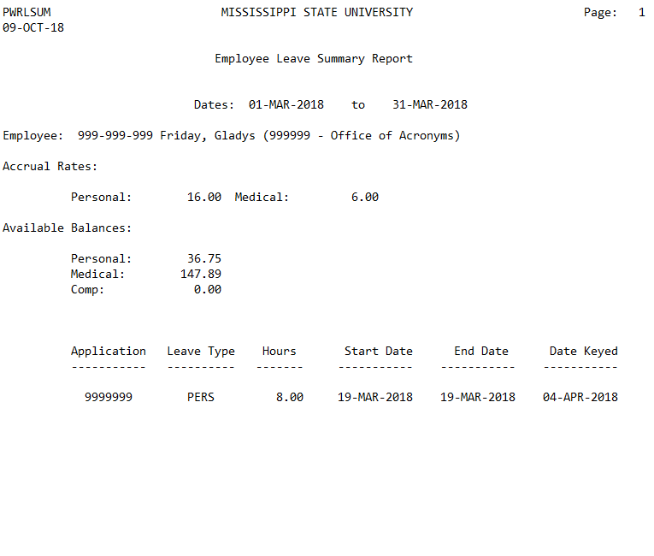


PWRLSUM: Employee Leave Summary Report
Timely
Signed by the reconciler
Signed by reviewer (DH) for the processor’s leave
Note: Documentation exists to support that leave usage and balances are reviewed timely and independent review of the processor's leave

Slide 20
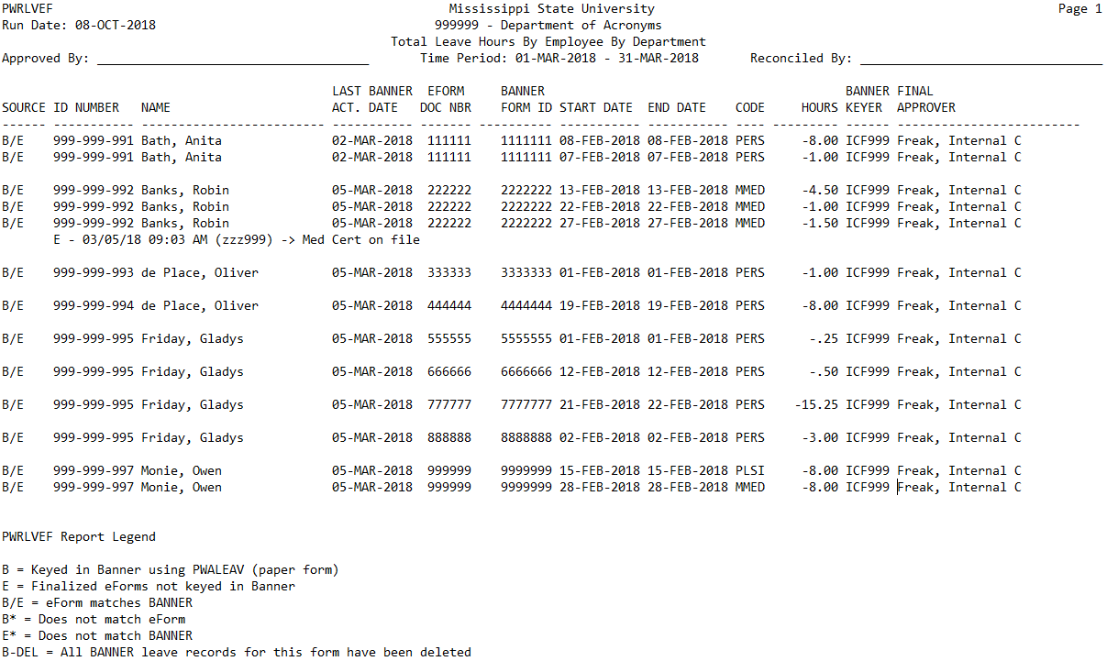
PWRLVEF: Banner/eForm Leave Reconciliation
Timely
Signed by the reconciler
Signed by reviewer (DH)
This recon was not performed timely
(i.e. this would be a finding!)

Slide 21
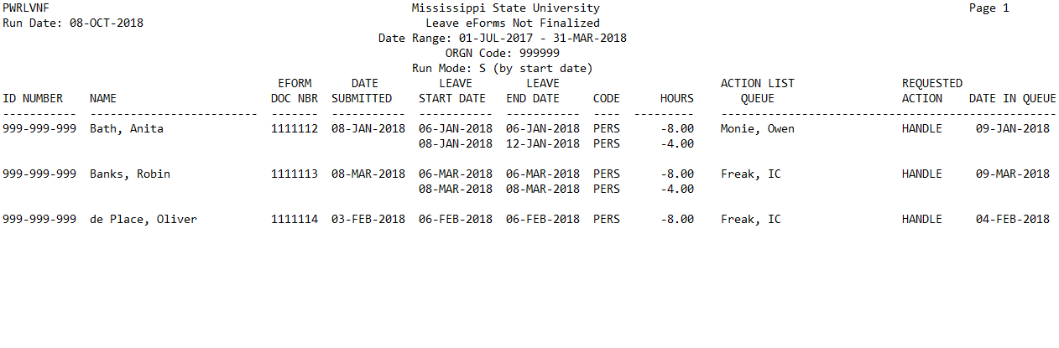
PWRLVNF: Leave eForms Not Finalized
Reconciled by:
Reviewed by:
This recon was not performed timely
(i.e. this would be a finding!)
Note: This a 2-part report.
1st Part (or page) shows leave eForms not finalized (which means the eForm is in someone’s queue, but not processed). Use this page of the report to follow up on any old eForms still in an action queue.

Slide 22
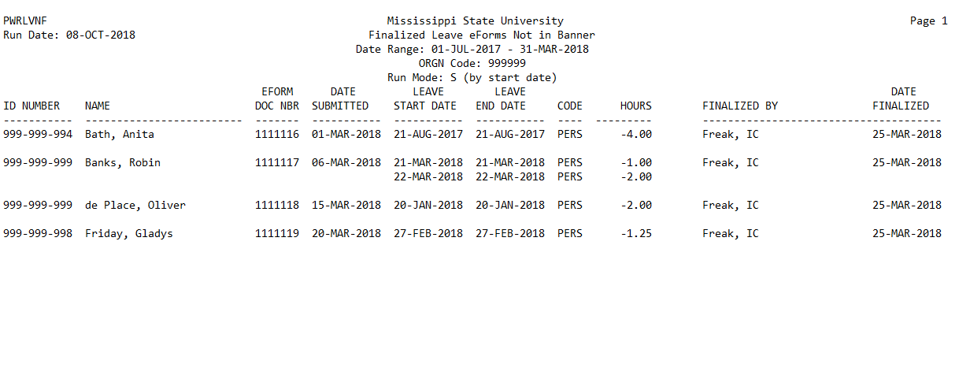
PWRLVNF: Finalized Leave eForms Not in Banner
Reconciled by:
Reviewed by:
This recon was not performed timely
(i.e. this would be a finding!)
Note: This a 2-part report.
2nd Part (or page) shows finalized leave eForms not in Banner (has not been uploaded into Banner yet). Use this page of the report to follow up on any eForms finalized but not uploaded into Banner.

Slide 23
Records of Hours Worked
University Policy:
60.109, Records Management & Security
60.311, Overtime/Compensatory Time
60.320, Office Hours/Work Schedule
What we look at:
Payroll Voucher (PWRVOCC)
Post-Time Entry Report (PWRVOCH)
Employee time sheets
Employee leave forms (paper or eForms)
What we look for:
Time sheets signed and dated by employee and DH
Time sheets reconcile to leave forms
PWRVOCH reconciles to time sheets and PWRVOCC
PWRVOCH and PWRVOCC signed and dated by reconciler and DH
Reconciliations performed timely (monthly)
Time sheets are maintained by the department for all non-exempt employees (based on federal/state law)
  Non-exempt employees are clerical, paraprofessional, etc.
  Generally any employee showing up on the Post-Time Entry Report
Proper segregation of duties (the more duties are separated, the better the internal controls)
  At a minimum, two people should be involved in the payroll process
  Time sheets should not be delivered for input by the employee or student represented. After reviewing and signing, the supervisor should directly forward timesheets for processing.

Slide 24
Records of Hours Worked
University Policy:
60.109, Records Management & Security
60.311, Overtime/Compensatory Time
60.320, Office Hours/Work Schedule
What we look at:
Payroll Voucher (PWRVOCC)
Post-Time Entry Report (PWRVOCH)
Employee time sheets
Employee leave forms (paper or eForms)
What we look for:
Time sheets signed and dated by employee and DH
Time sheets reconcile to leave forms
PWRVOCH reconciles to time sheets and PWRVOCC
PWRVOCH and PWRVOCC signed and dated by reconciler and DH
Reconciliations performed timely (monthly)
Reconcile record of hours worked:
  Reconcile time sheets to Post-Time
  Reconcile from Post-Time Entry Report to Payroll Vouchers
  Reconcile Payroll Vouchers (PWRVOCC) to ledger reports (FWREXEG)
Time Sheets
Post-Time
Entry Report
(PWRVOCH)
Payroll Voucher
(PWRVOCC or
PWRDSPV)
Ledger Report
(FWREXEG or FWREXDP)

Slide 25
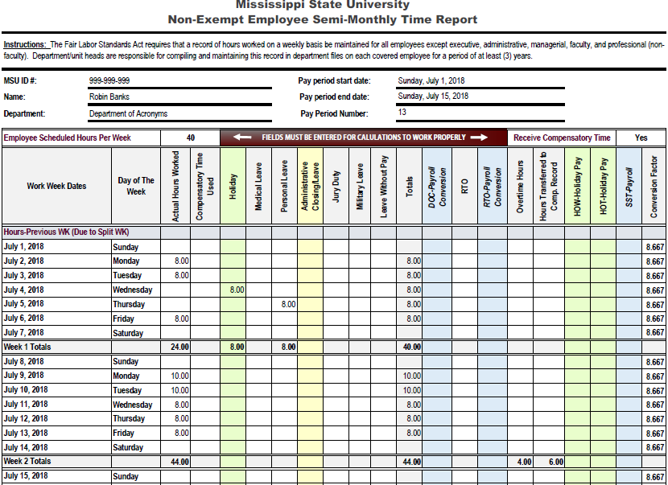
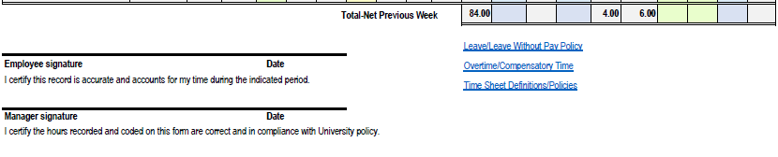


Time Sheets
Time sheets/cards appear accurate & include the recording of
  Holiday,
  Leave, and
  Compensatory time
Note: Leave and comp time should be compared to time sheets to ensure they agree

Slide 26
Time Sheets
Note: Time sheets/cards are signed and dated by the employee/supervisor after the time period being reported
Note: Signatures document agreements as to the hours worked.

Slide 27
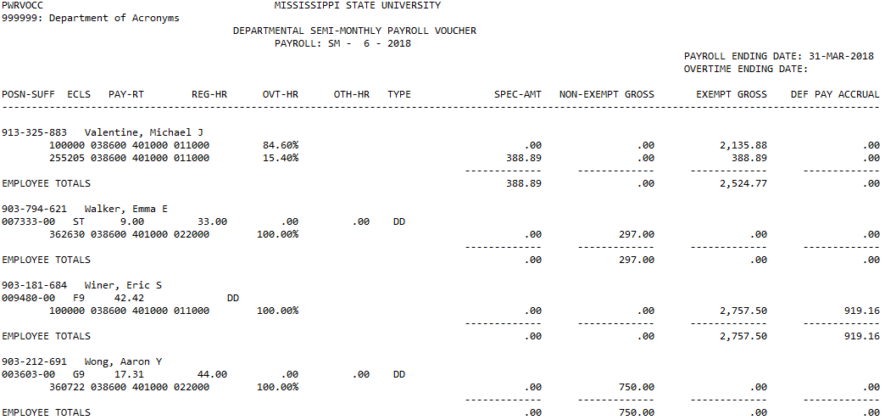
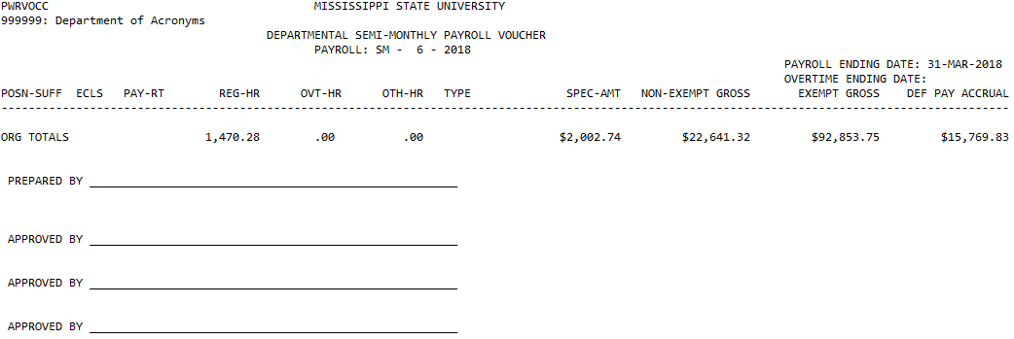


PWRVOCC: Payroll Voucher
Note: Documentation exists to support the Payroll Voucher is reviewed by the Department Head or designee

Slide 28
Compensatory Time
University Policy:
60.109, Records Management & Security
60.311, Overtime/Compensatory Time
60.320, Office Hours/Work Schedule
What we look at:
Departmental Leave Summary Report (PWRLDPT)
Employee time sheets
What we look for:
Comp time is recorded in Banner
Comp time is reconciled and reviewed with leave
Compensatory time (comp time) should be reconciled by one individual
  Comp time balances should be reconciled to time sheets and documentation retained
  Employees accruing comp time should not be responsible with keeping up with their own comp time
Comp balances/reconciliation should be reviewed and signed off by the DH or administrator
Comp time liability is held by the department in which the balance was accrued.
  This balance must be paid by the department when the employee transfers to another unit/dept or is terminated
Make sure employees use comp time before using personal leave
Maintain compensatory time in Banner (key accrued and taken in Banner similar to the leave process)

Slide 29
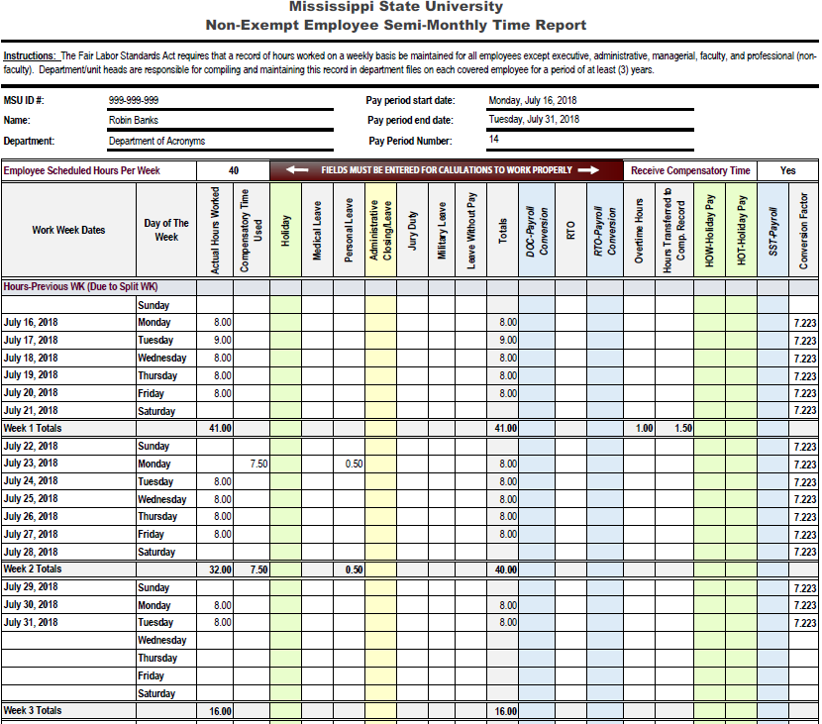
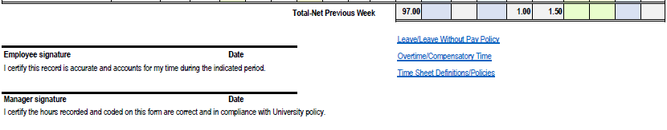

Time Sheets
Note: Comp time earned should be reflected on the time sheet and keyed into Banner. Only actual hours worked in excess of 40 hours can be transferred to compensatory time balance.

Slide 30
Cash Receipts/Handling
University Policy:
62.07, Cash Handling
What we look at:
Cash deposits
Cash log
Supporting documents
Ledger Report (FWREXEG)
What we look for:
Cash is deposited timely ($1000 or weekly, whichever first)
Cash deposits are reconciled to FWREXEG
Someone with knowledge is reviewing and signing off on the reconciliation
Cash handling duties are adequately segregated
Cash is stored in a secure location
Cash is defined as coin, currency, checks, money orders and credit card transactions
Because of the liquid nature of cash, it is highly scrutinized
Separation of duties: if possible, separate the components of cash handling (collecting, depositing, and reconciling). In small departments separate the handling of the actual cash from the reconciliation
Use pre-numbered receipts, cash log, register tape, etc. to document cash received
Cash received should be reconciled monthly from receipt documentation to revenues recorded in Banner

Slide 31
Procurement Card
University Policy:
Procurement Card User’s Guide
What we look at:
Procard Regions statement
Procard journal voucher (FWGJVLST)
Procard log
What we look for:
Procards are adequately secured
Regions Procard statements are signed and dated by reconciler and DH
Procard logs exist and have complete information when multiple employees use a procard
Ensure Compliance with State Bid Laws
Card transactions are adequately supported and reconciled to bank statements
  Transactions should be reviewed for reasonableness and compared to actual vendor receipts
  Document the purpose of unusual purchases or vague receipts (we will ask you about them)
Documentation exists to support review of procurement card statements
  DH dates and signs on the actual Regions Procard statement certifying his/her review of the transactions
  Reviewer must be knowledgeable about what should or should not be purchased/charged on the card and should question unusual purchases
When multiple employees use a procard, a log should be used to track user name, date, check-in/out times, location of use, purpose, etc.

Slide 32
Property Management
University Policy:
Property Management Manual
What we look at:
Annual self audit
Hand receipts
What we look for:
The most recent self audit was completed and submitted on time to Property Control
A check-in/out process for assets and hand receipts are being issued
DH approves the inventory rep’s hand receipt
Annual Self Audit should be performed by someone other than or in addition to the inventory representative
Hand receipts must be used for the removal of property off campus & updated annually
  Should be able to produce the asset or a hand receipt at all times
  We recommend that a hand receipt be completed for any portable assets (such as laptops) assigned to an employee
  Hand receipts should be:
    completed in their entirety
    assets visually inspected
    signed by the inventory representative
    done one when new equipment comes in, and then annually thereafter (i.e. every July)

Slide 33
Fleet Management
University Policy:
Fleet Management Guidelines & Procedures Manual
What we look at:
Vehicle log
Business Use Agreements
Fuelman statements
InCircuit vehicle report
What we look for:
A vehicle log exists and is complete for each vehicle
A Business Use Agreement is on file with the department for every driver
Fuel statements are reconciled to vehicle logs
A vehicle log for each vehicle should be used to document every trip in a University vehicle; the log should capture the following:
user name, beginning and ending odometer readings, beginning and ending date and time, destination, fueling quantity and cost, and a description and cost of any required maintenance. For Fuelman purchases, the cost will match the cost per the receipt due to state negotiated fuel prices.
MSU Business Use Agreement should be on file for every driver of a MSU vehicle
Fuel statements should be reconciled to vehicle logs

Slide 34
Fleet Management
University Policy:
Fleet Management Guidelines & Procedures Manual
What we look at:
Vehicle log
Business Use Agreements
Fuelman statements
InCircuit vehicle report
What we look for:
Only authorized employees have access to fuel
Fuel cards are secure
Employees are not sharing PINs
Fuel statements reviewed and signed by DH
InCircuit Vehicle report is reviewed by DH
(cont.)
Fueling of Fleet (Fuelman or MAFES Motor Pool)
Have a process for adding and removing individuals to the fuel card system; make sure your listing of authorized personnel is current
Fuel cards should be stored in a secure location; do not store them in the vehicle
Each driver of a MSU vehicle should have their own PIN; employees should not share PINs
Fuel statements should be reviewed and signed by DH; look for unusual transactions such as excessive fuel purchases or gallons purchased in excess of the fuel tank capacity (is the fuel making it into the MSU vehicle?)
InCircuit Vehicle Cost & MPG Analysis report should be reviewed by DH; look for unusual miles per gallon usage by vehicle (is this vehicle costing you more than it is worth?)

Slide 35
Facilities Management
University Policy:
91.354, Facilities Use
79.10, Facility Safety Reviews
01.10, Information Security
What we look at:
Master key listing
Department’s record of keys issued
Department’s key check-in/out process
Storage of unused keys
What we look for:
Unused keys are secure
Department has adequate key issuance procedure
Department has adequate key records
Terminated employees no longer have access
Maintain an accurate record of keys issued and periodic analysis of missing keys to ensure adequate security
  When was the last time your office, suite, or building was keyed/rekeyed?
  Can you account for all keys issued? Are your people/students, property, and information adequately secured?
Make sure the record of keys includes both issued and unissued keys
Clean up your key listing. Request a key listing from Facilities and reconcile from your listing of keys to theirs
For Total Card users should periodically run the new ITS report (TC1917RP) to identify individuals with access

Slide 36
Sponsored Research
University Policy:
Sponsored Programs Accounting Time and Effort Quick Reference Guide
What we look at:
Confirmation of Effort reports
What we look for:
Someone with suitable means of verification (direct & verifiable) confirmed effort
Timely and accurate completion of Confirmation of Effort reports by someone with suitable means of verification that the work was performed
Most common finding is failure to submit reports timely
Make sure your employees understand what they are signing

Slide 37
Travel
University Policy:
13.08, Travel by Faculty and Staff
62.01, Travel
MSU Travel Guidelines (http://www.travel.msstate.edu/procedures/guidelines.php)
According to the MISSISSIPPI CODE OF 1972, Annotated, Section 25-3-45: "It shall be unlawful for any person to claim, receive, approve, or allow any item of expense for official travel in excess of that authorized by Section 25-3-41. If any person shall knowingly and willfully violate any of the provisions of said section, such person shall be guilty of a misdemeanor and, upon conviction, shall be punished by a fine of not more than two hundred fifty dollars and, in addition, shall be removed from the office or position which he holds. Such person shall also be civilly liable for the full amount of the expense account illegally received, allowed, or approved by him, and the person receiving same shall be so liable whether the violation be willful or not."

Slide 38
Travel
University Policy:
13.08, Travel by Faculty and Staff
62.01, Travel
MSU Travel Guidelines (http://www.travel.msstate.edu/procedures/guidelines.php)
MSU does not reimburse employees for the personal use of personal vehicles…
Commute
Oil changes on a personal vehicle
Shopping trips
Running personal errands

Slide 39
Travel
University Policy:
13.08, Travel by Faculty and Staff
62.01, Travel
MSU Travel Guidelines (http://www.travel.msstate.edu/procedures/guidelines.php)
Prior approval of the Dept Head/Director is required for the following circumstances
  Attending in- or out-of-state conventions, associations, conferences, workshops, seminars and clinics.
  Outside the State of Mississippi but within the United States for reasons other than those listed above
Allowable Travel Costs include
  Subsistence
  Transportation
  Other Travel costs

Slide 40
Travel
University Policy:
13.08, Travel by Faculty and Staff
62.01, Travel
MSU Travel Guidelines (http://www.travel.msstate.edu/procedures/guidelines.php)
Subsistence
  Meals:
    State law (Miss. Code Ann. § 25-3-41) allows employees to be reimbursed the actual cost of meals not to exceed the daily maximums for the specific location
    Reimbursement for meals is allowable if travel involves an overnight stay.
  Lodging

Slide 41
Travel
University Policy:
13.08, Travel by Faculty and Staff
62.01, Travel
MSU Travel Guidelines (http://www.travel.msstate.edu/procedures/guidelines.php)
Transportation
  Travel Routing:
    Reimbursement will be made for the most direct, practicable route, regardless of the method of travel utilized.
  Travel in a Privately Owned Vehicle (POV)
    MSU has two rates for reimbursing POV mileage:
      If no MSU vehicle is available, the full federal rate ($0.535/mile as of 7/11/17)
      $0.17/mile if a MSU vehicle is available
    If travel is beginning and/or ending from home, the employee will be reimbursed for the lesser of miles calculated starting and finishing the trip from work or starting and or finishing the trip from home

Slide 42
Information Security
University Policy:
01.10, Information Security
01.11, Policy on Access to IT Resources
01.12, Use of IT Resources
01.23, Social Security Number Usage
What we look at:
Security of sensitive information
Employee Banner access
Termination Checklist
What we look for:
Sensitive information is adequately secure
Portable devices are encrypted
Banner access for employees is consistent with job responsibilities
Separated employees no longer have access
Sensitive information is secured, such as: SSN, Financial records (donor, student, employee), Personnel/HR records, Student Records, Research data
Departmental policy should require password protection on computers and encryption software on portable devices (i.e. laptops, flash drives)
Completion of the information security training by employees
Documentation to support compliance with software licensing agreements (proof of ownership/license agreements for installed software)
Employees are enrolled in MSU Double authentication (DUO). Run PWRCDUO report to identify those not enrolled

Slide 43
General Administration
Best Practice
What we look at:
Desk manuals
Whistleblower poster
What we look for:
Desk manuals exist for the critical processes of each employee
Whistleblower poster is posted centrally in the department
Current desk manual exists for critical departmental controls and procedures
We recommend that a desk manual be developed detailing critical procedures in the event of hiring a new employee or temporary worker substituting for an absent employee
We recommend that the manual detail tasks to be completed daily and tasks completed periodically/monthly with recommended timelines. The manual should be reviewed periodically with any changes noted
Whistleblower poster containing EthicsPoint information is posted centrally in the department

Slide 44

Questions
“Contemplating any business act, an employee should ask himself whether he would be willing to see it immediately described by an informed critical reporter on the front page of his local paper and thus be read by his spouse, children, and friends.”
-Warren Buffett

