Slide 1
Basic Control Assessments and Continuous Monitoring Audits
Office of Internal Audit
www.audit.misstate.edu
Business Managers & Business Coordinators Training
April 17, 2024

Slide 2
About
Lesia Ervin, Audit Director
MSU graduate
Experience… Over two decades of audit experience
MSU Office of Internal Audit
University of Houston’s Internal Audit
Arthur Andersen LLP, Houston, TX
Oversees:
Operational, Compliance, IT, & Departmental Audits
Investigations of Fraud, Waste, & Abuse
Management of the University’s Hotline

Slide 3
About
Jordan Ramsey, Audit Director
MSU graduate
Masters of Business Administration
Dual degrees in International Business with an emphasis in Business and Spanish
Experience… Over 15 years of audit experience, primarily within higher education including serving on several peer review teams
Oversees:
IT Audits
Consulting Projects
Investigations of Fraud, Waste, and Abuse
Management of the University’s Hotline

Slide 4
About
Tyler Morgan, Audit Manager
MSU graduate
Experience:
T.E. Lott and Co. (2014-2017)
Mississippi Office of the State Auditor (2017-2020)
MSU Office of Internal Audit (2020-present)

Slide 5
Road Map for Today’s Presentation
Preliminaries, overview of Internal Audit and types of audits, and primer on internal controls
Continuous monitoring audits
Basic control assessments

Slide 6
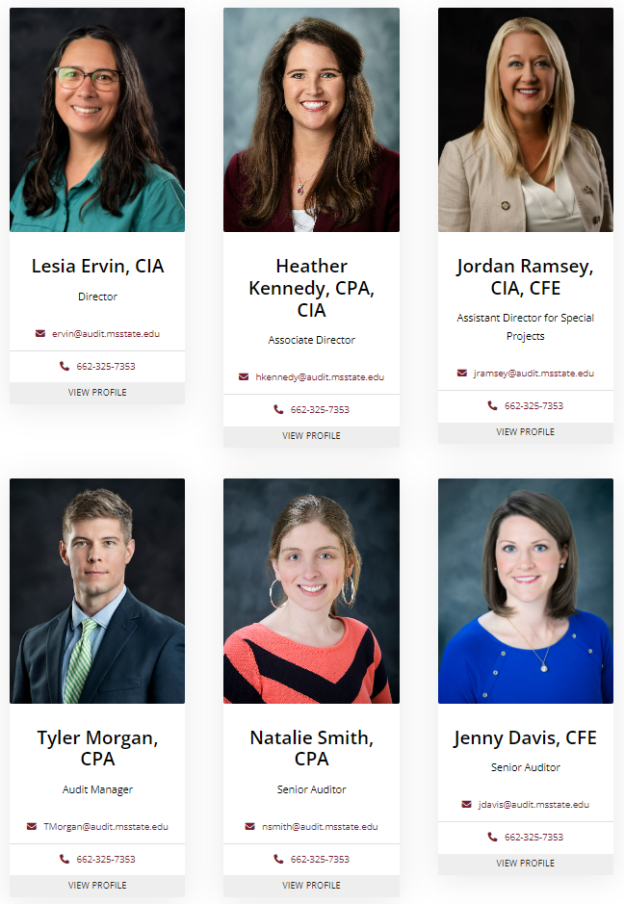

Slide 7
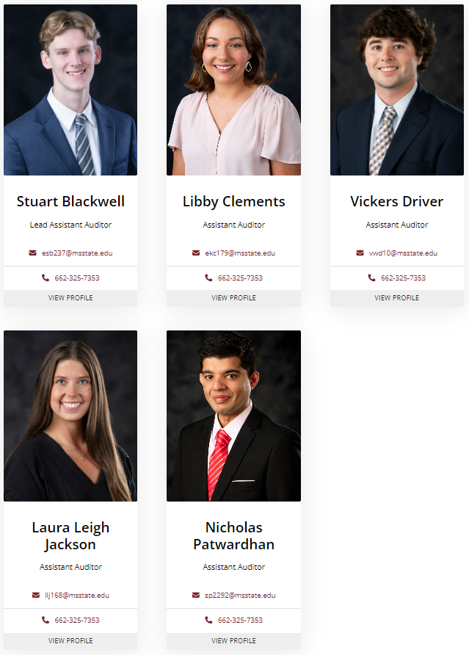

Slide 8
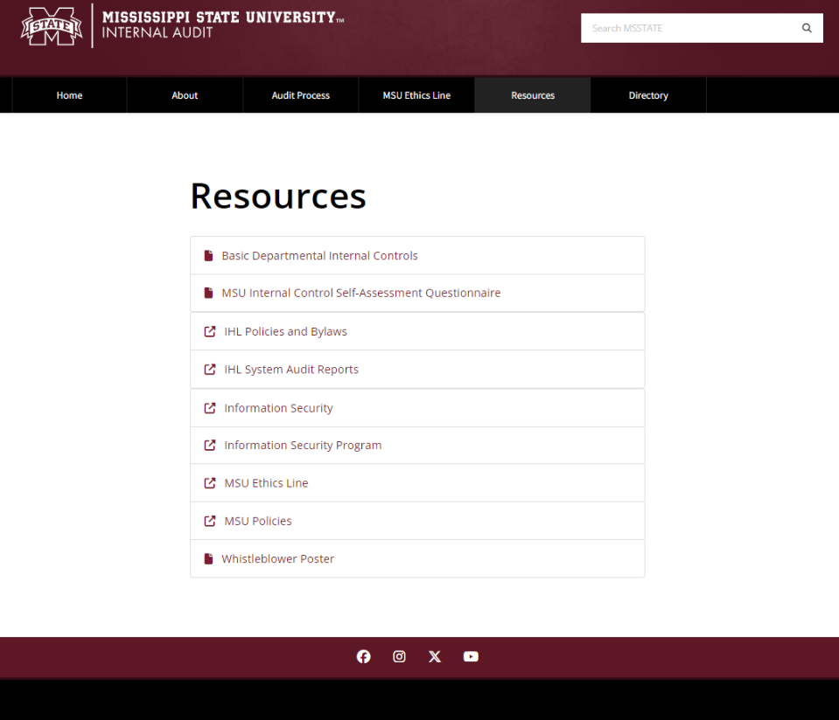
Resources at Internal Audit’s Website

Slide 9
Internal Control Self-Assessment Questionnaire
Voluntary
Thorough - 18 pages of information
For fans of checklists
See what you’re missing or haven’t thought about
Areas covered include:
Procurement
Travel
Payroll
Leave
Reconciliations
Revenues / Cash Handling
Facilities Management
Equipment / Inventory
Fleet Management
Sponsored Research
And more

Slide 10
MSU ETHICS LINE

Slide 11
MSU Ethics Line – What It’s For
Violations of state and federal laws
Violations of University policy
Misuse of University property, resources, or authority for personal gain

Slide 12
MSU Ethics Line – Info
By web: www.msstate.edu/ethics-line/
By phone: 877-310-0424
Independently operated to ensure confidentiality where desired
Process initiated by Internal Audit – reports taken seriously

Slide 13
WHISTLEBLOWER POSTER

Slide 14
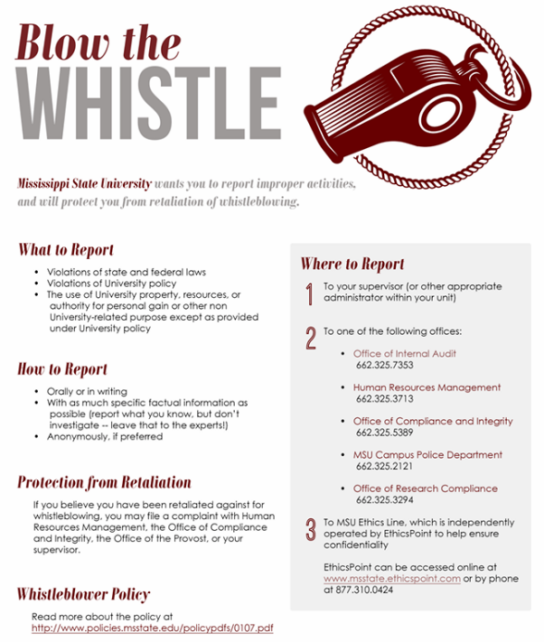

Slide 15
It’s Also On Our Website!

Slide 16
Types of Internal Audits at MSU
Basic Control Assessment
Process Audit
Continuous Audit
Investigation
Follow-up

Slide 17
Why Do We Audit?
Identification and evaluation of risks
FROCS
Financial
Reputational
Operational
Compliance
Strategic

Slide 18
Why Do We Audit?
Internal controls – are they sufficient to manage risks?

Slide 19
Internal Controls
Internal controls - processes that provide reasonable (not absolute) assurance that particular objectives are achieved.
Control activities include a range of activities such as:
Approvals
Authorizations
Verifications
Reconciliations
Security of assets
Segregation of duties
We use internal controls for the following purposes:
Protect MSU/State of MS assets
Ensure records are accurate
Promote operational effectiveness and efficiency
Encourage adherence to policies
Ensure compliance with laws, regulations, and contracts

Slide 20
Types of Internal Controls
Control activities are actions supported by policies and procedures to manage risk.
PREVENTATIVE
Proactive controls to prevent loss
Designed to discourage errors or prevent irregularities from occurring
DETECTIVE
Provide evidence a loss has occurred
Designed to find errors/irregularities after they have occurred
Examples:
Segregation of Duties
Transaction Approvals
Adequate Documentation
Physical Control over Assets
Examples:
Reviews
Reconciliations
Physical Inventories
Analyses or Variance Analyses

Slide 21
WE ARE, IN FACT, ON THE SAME TEAM

Slide 22
CONTINUOUS MONITORING AUDITS

Slide 23
Continuous Monitoring Audits - Overview
New (fall 2023)
Limited – Focus on one area in each audit
Account Reconciliations
Separation Checklists
Will add more later (e.g., payroll, research)
Sample across multiple departments / areas for each audit
Typically unannounced

Slide 24
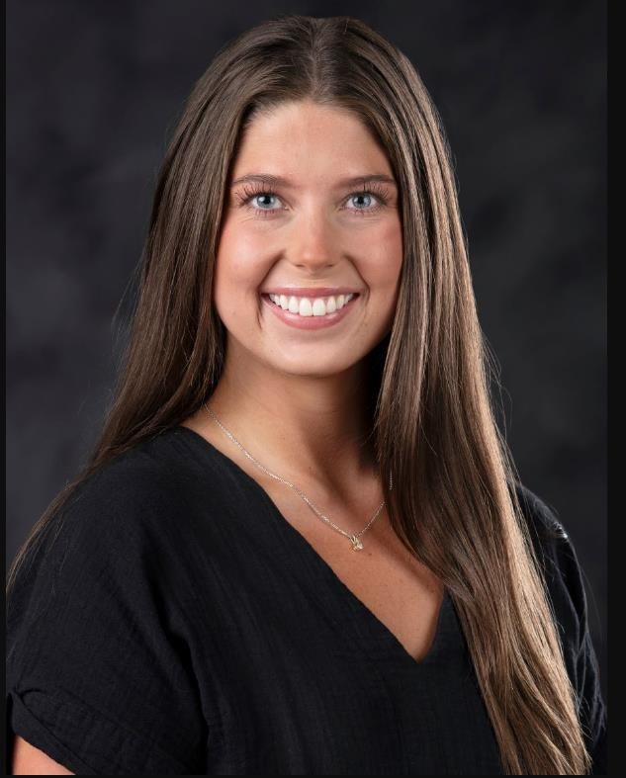
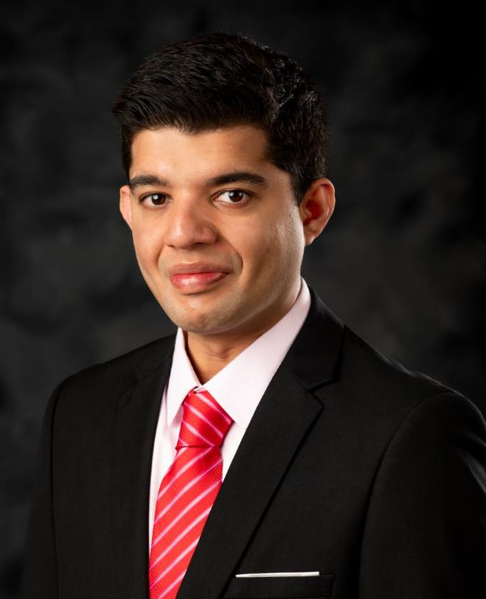
LAURA LEIGH
NICK
Not sure it’s Internal Audit? Ask for identification, visit our website, and/or call us.

Slide 25
Continuous Monitoring Audits - Overview
Reports addressed to Dr. Keenum. VPs and deans copied
No follow-ups, but will select areas with issues more frequently
Goal is to get as much coverage of University as possible
Perception of detection culture

Slide 26
Continuous Monitoring Audits – Account Reconciliations
Required by MSU Policy 61.01
A formal reconciliation of revenues and expenditures should be performed monthly
Process may vary, but
Ledger reports (FWREXEG and FWREXDP)
Signed by Preparer and Reviewer

Slide 27
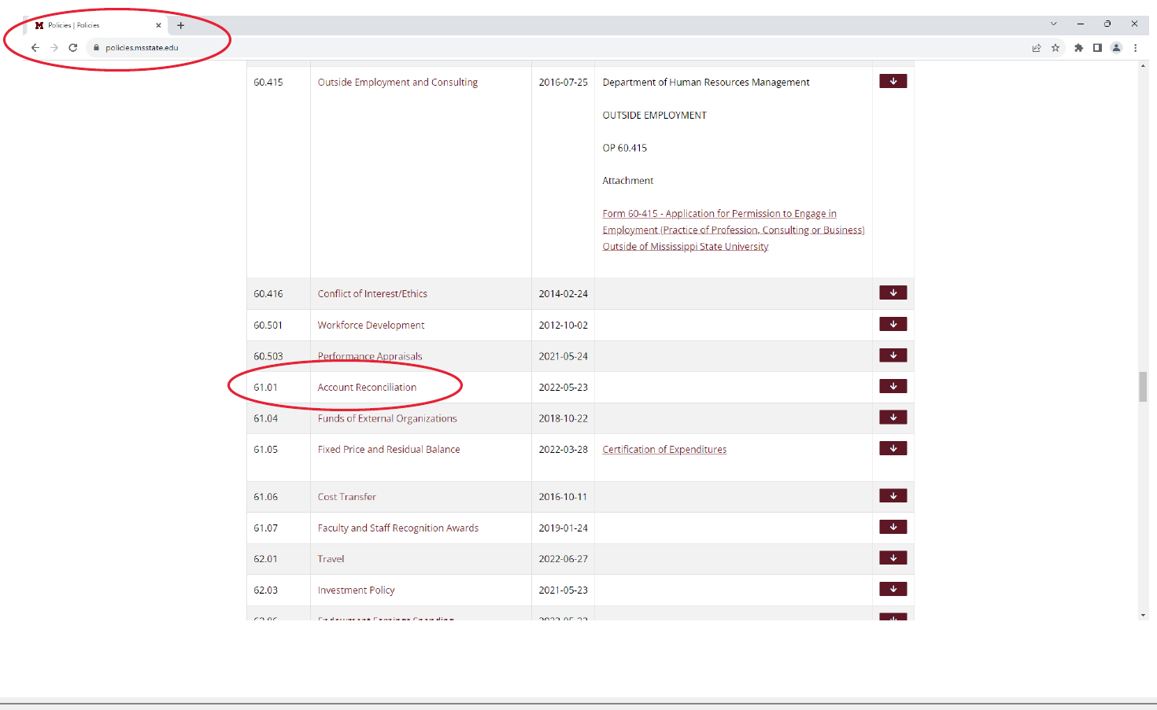

Slide 28
How do I know what needs to be reconciled?

Slide 29
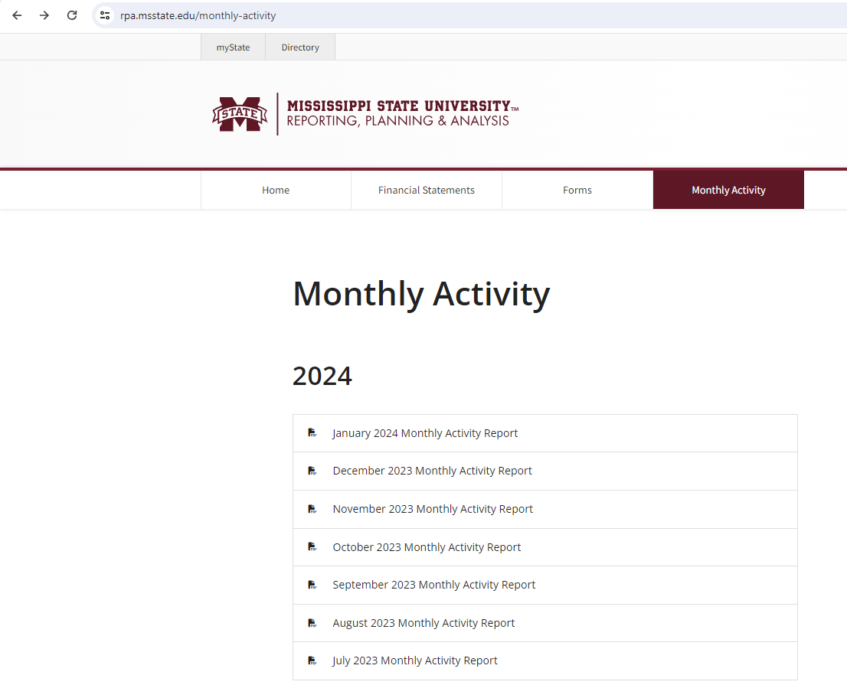
Account Reconciliations – Monthly Activity Report

Slide 30
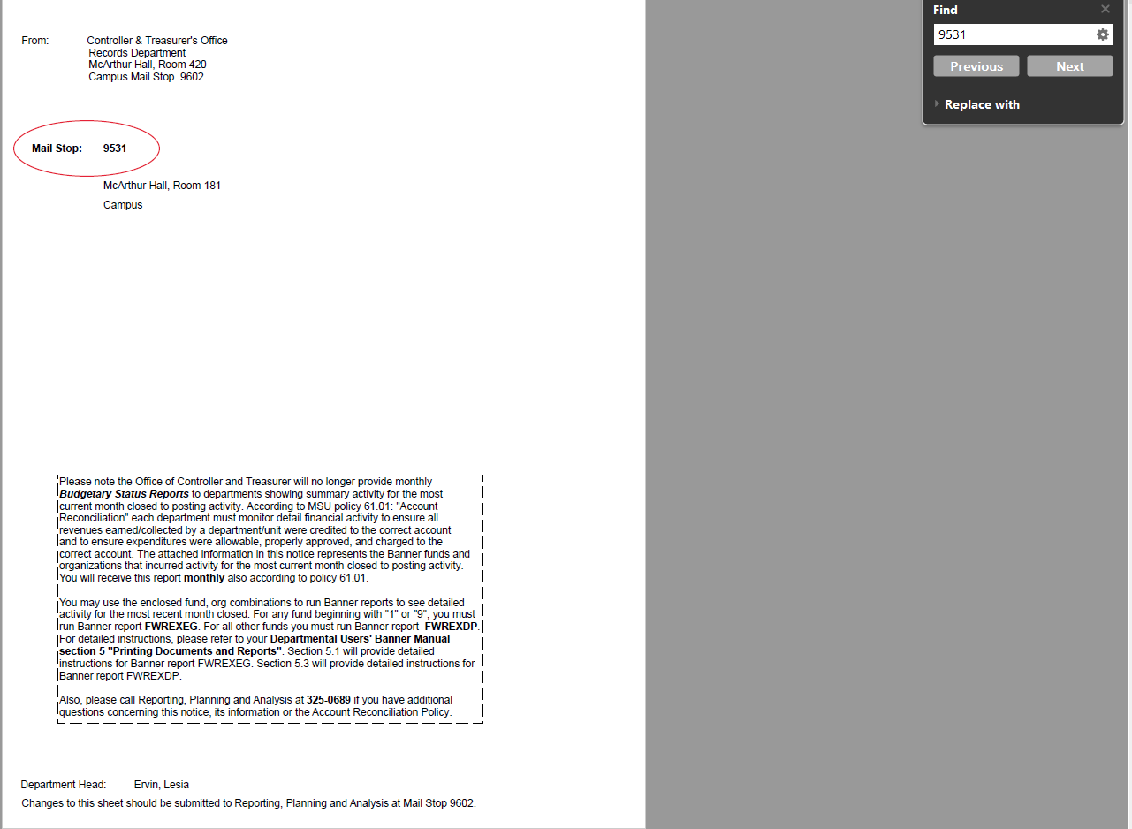
Account Reconciliations – Monthly Activity Report

Slide 31
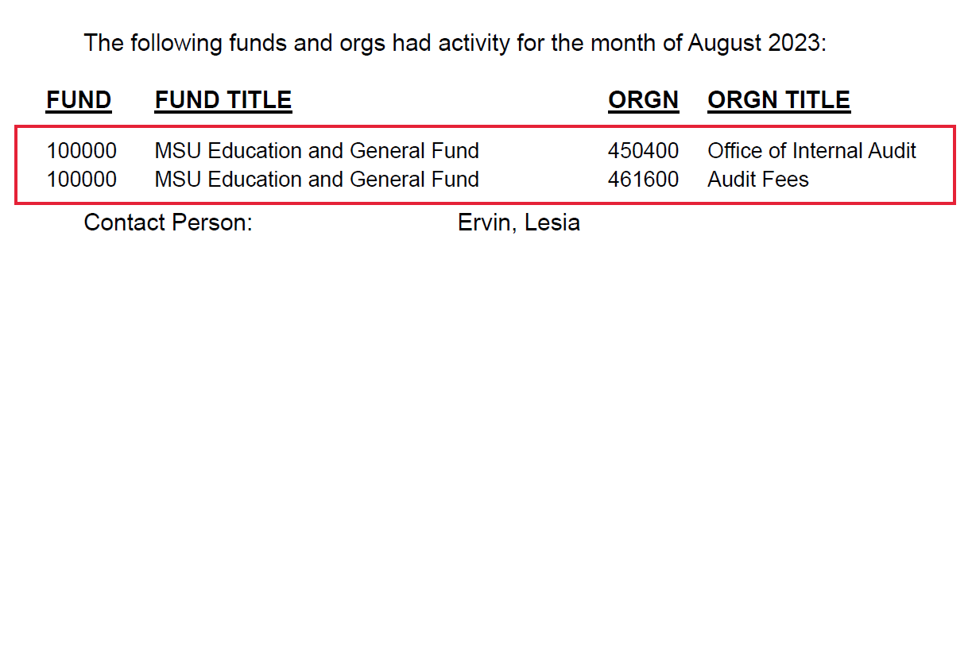
Account Reconciliations – Monthly Activity Report

Slide 32
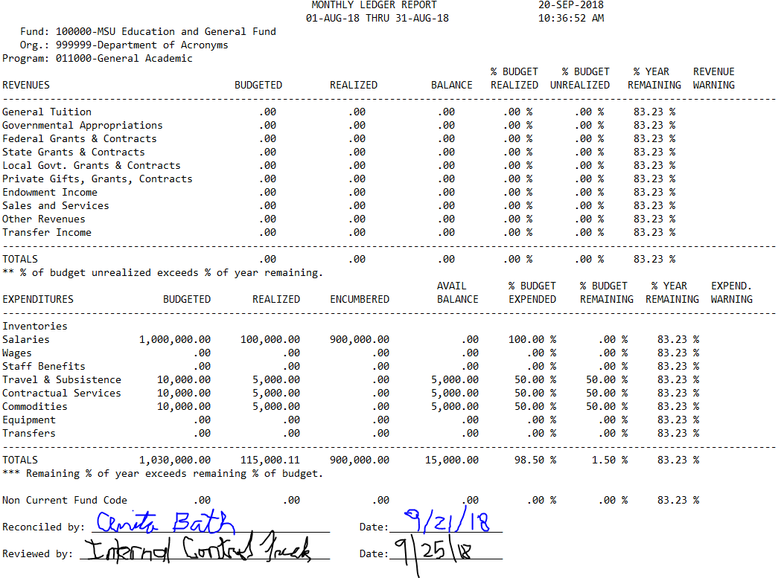
FWREXEG: Monthly Ledger Report
Signed by reconciler
Signed by reviewer (Dept. Head or PI for grants)
Timely

Slide 33
Continuous Monitoring Audits – Separating Checklists
Required by MSU Policy 60.405
Departments must complete and maintain the Separating Procedure Checklist when:
Employee terminates
Employee transfers
Primary purpose: Removal of access (buildings, keys, sensitive information, software)
Signed by preparer
Should be completed ASAP, preferably at time of termination or transfer

Slide 34
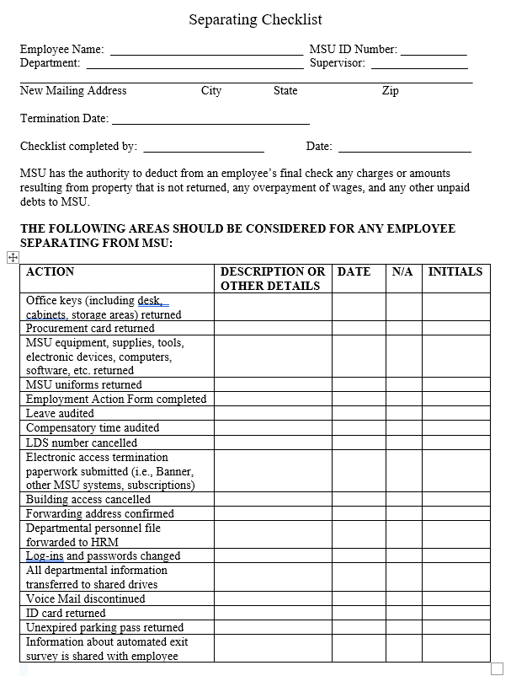
Continuous Monitoring Audits – Separating Checklists

Slide 35
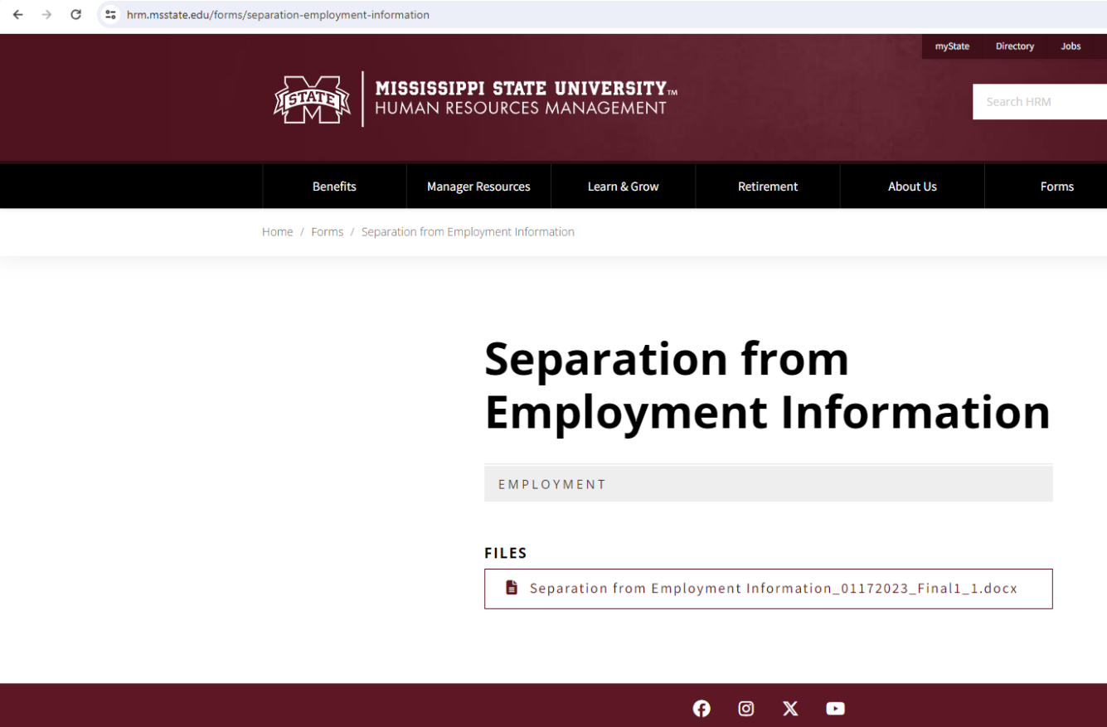
Continuous Monitoring Audits – Separating Checklists

Slide 36
Continuous Monitoring Audits – Separating Checklists
Feel free to customize
Update of standard checklist underway
Make sure to sign and date it

Slide 37
BASIC CONTROL ASSESSMENTS (BCAs)

Slide 38
BCA Areas
Account Reconciliations
Research
Cash
Leave/Payroll
Procurement Card
Fleet Management
Facilities Management
Information Security
General Administration
Management Review: 16%
Internal Audit: 14%
Tip: 42%

Slide 39
Research – Time and Effort Reports

Slide 40
Research – Time and Effort Reports

Slide 41
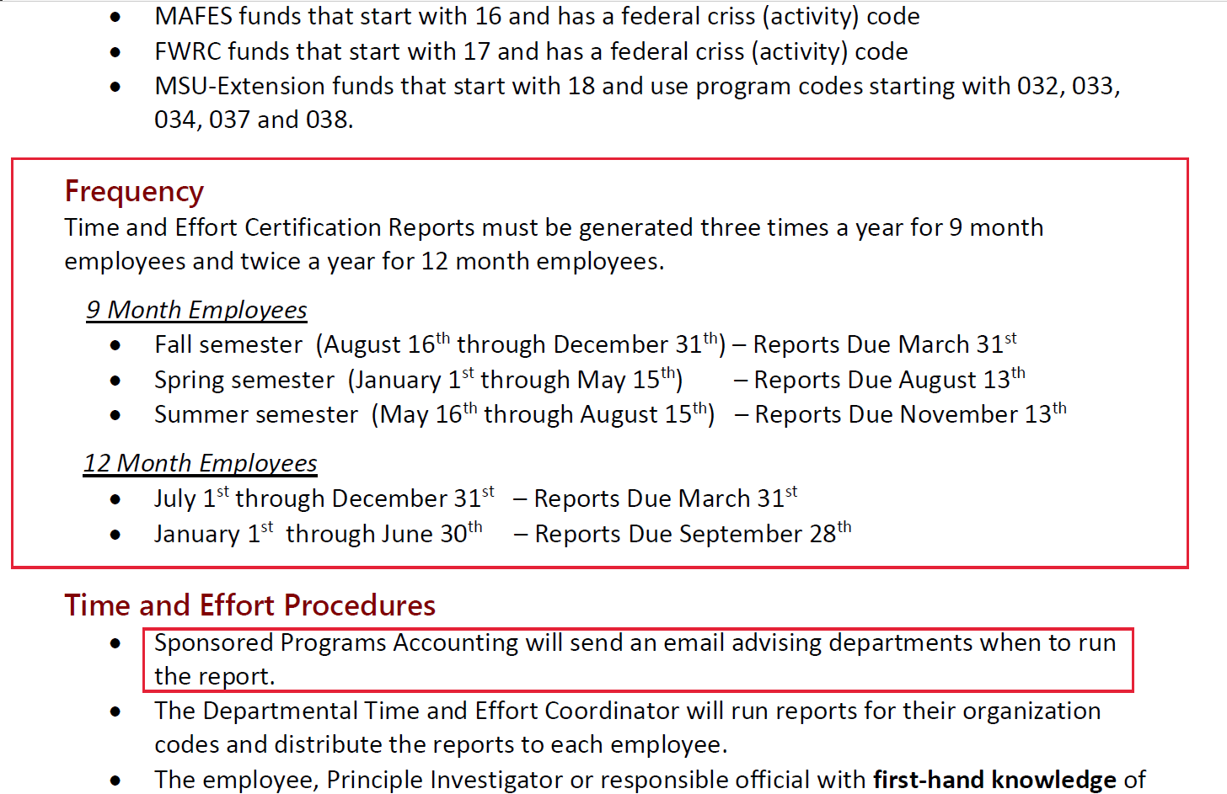
Research – Time and Effort Reports

Slide 42
Research – Time and Effort Reports
Timely and accurate completion of Time and Effort reports by someone with suitable means of verification or first-hand knowledge of the work performed
Most common findings are failure to submit reports timely or signature by someone without suitable means of verification
Make sure your employees understand what they are signing

Slide 43
Cash Receipts/Handling
Cash is defined as coin, currency, checks, money orders and credit card transactions
Because of the liquid nature of cash, it is highly scrutinized
Separation of duties: if possible, separate the components of cash handling (collecting, depositing, and reconciling). In small departments separate the handling of the actual cash from the reconciliation
Use pre-numbered receipts, cash log, register tape, etc. to document cash received
Deposit weekly or once cash on hand reaches $1,000, whichever comes first
Cash received should be reconciled monthly from receipt documentation to revenues recorded in Banner

Slide 44
Leave
All eligible employees should be reporting leave usage
The authorization or taking of leave without the completion and submission of appropriate leave forms is considered a misuse of assets (Policy 01.19) and subject to disciplinary action
Documentation should exist to support that leave usage and balances are reconciled timely

Slide 45
Leave: Reconciliation
Banner Reports for Leave Reconciliation:
Departments using paper leave forms:
PWRLSUM (Employee Leave Summary Report)
PWRLVTL (Employee Leave Totals by Org Report)
Departments using eForms:
PWRLVEF (Banner/E-Form Leave Reconciliation)
PWRLVNF (E-Forms not Finalized)

Slide 46
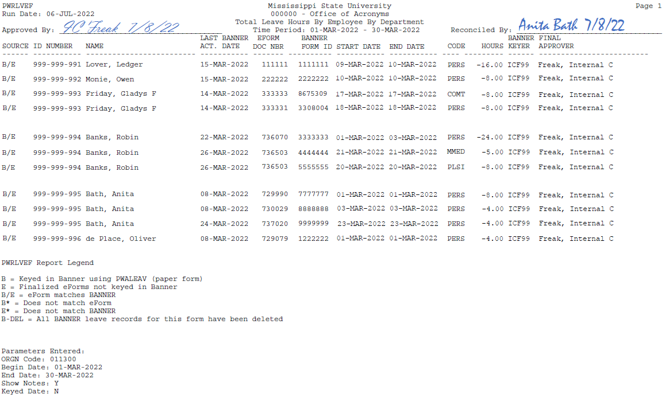
PWRLVEF: Banner/eForm Leave Reconciliation
Timely?
Signed by the reconciler
Signed by reviewer (DH)
This recon was not performed timely.
(i.e. this would be a finding!)

Slide 47
PWRLVNF: Leave eForms Not Finalized
This recon was not performed timely.
(i.e. this would be a finding!)
Note: This a 2-part report.
1st Part (or page) shows leave eForms not finalized (which means the eForm is in someone’s queue, but not processed). Use this page of the report to follow up on any old eForms still in an action queue.

Slide 48
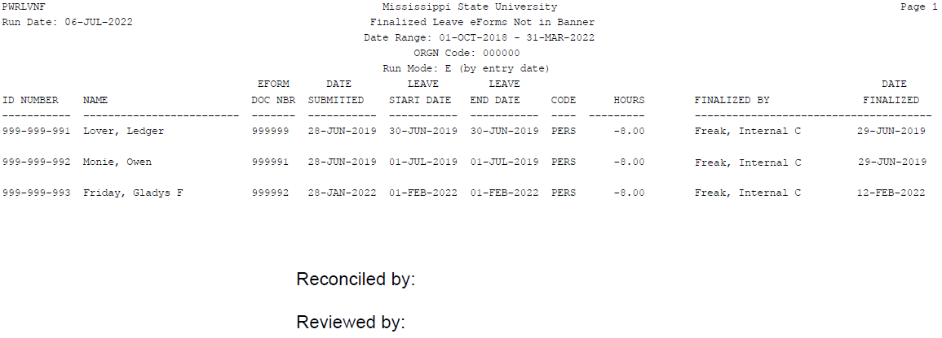
PWRLVNF: Finalized Leave eForms Not in Banner
This recon was not performed timely.
(i.e. this would be a finding!)
Note: This a 2-part report.
2nd Part (or page) shows finalized leave eForms not in Banner (has not been uploaded into Banner yet). Use this page of the report to follow up on any eForms finalized but not uploaded into Banner.

Slide 49
Payroll
Timesheets are maintained by the department for all non-exempt employees (based on federal/state law)
Non-exempt employees are clerical, paraprofessional, etc.
Any employee showing up on the Post-Time Entry Report
Timesheets signed by supervisor and employee ON OR AFTER last day worked
Timesheets should not be given back to employees to turn in

Slide 50
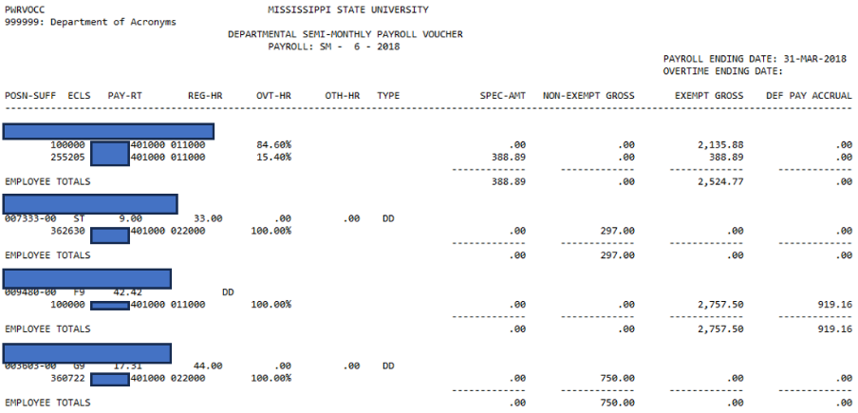
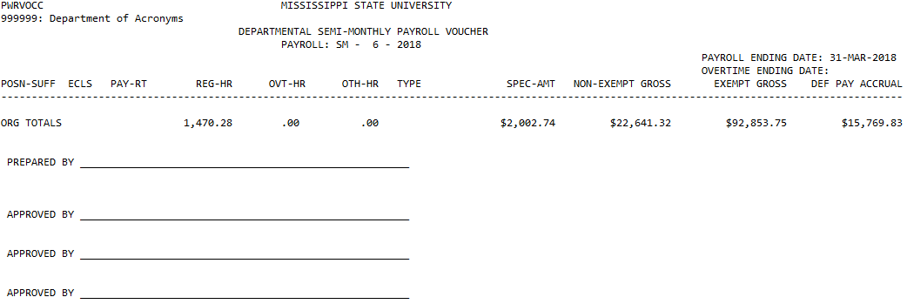
PWRVOCC: Payroll Voucher
Note: Documentation exists to support the Payroll Voucher is reviewed by the Department Head or designee

Slide 51
Compensatory Time
Maintain comp time in Banner
Comp time liability is held by the department in which the balance was accrued.
This balance must be paid by the department when the employee transfers to another unit/department or is terminated
Make sure employees use comp time before using personal leave

Slide 52
Procurement Card
Ensure compliance with state laws
Watch out for split purchases
If multiple employees use a pro card, use a log to track user name, date, check-in/out times, location of use, purpose, etc.
Review transactions for reasonableness
Document purpose of unusual purchases
Department Head (or designee) signs pro card statement as evidence of review

Slide 53
Fleet Management
A vehicle log for each vehicle should be used to document every trip in a University vehicle off campus
Fuelman PIN #s
Don’t share
Deactivate for terminated employees
ReCoup (Assetworks) MPG report should be run monthly
Signed by Department Head (or designee)
NOT a formality; should be scrutinized

Slide 54
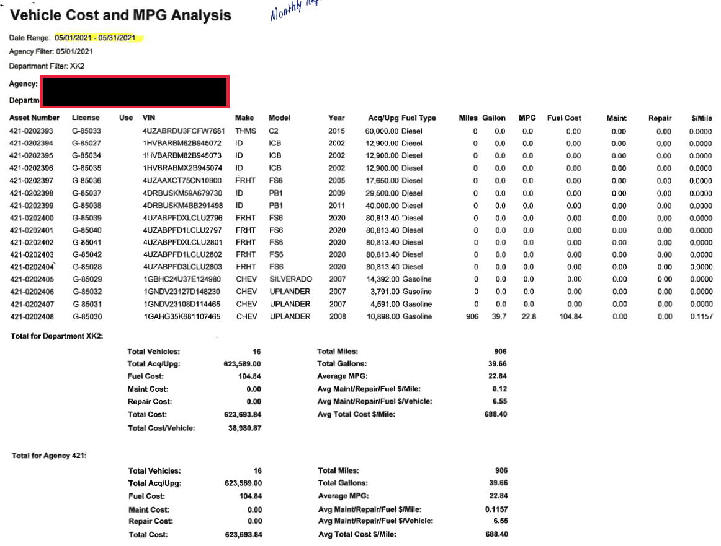

Slide 55
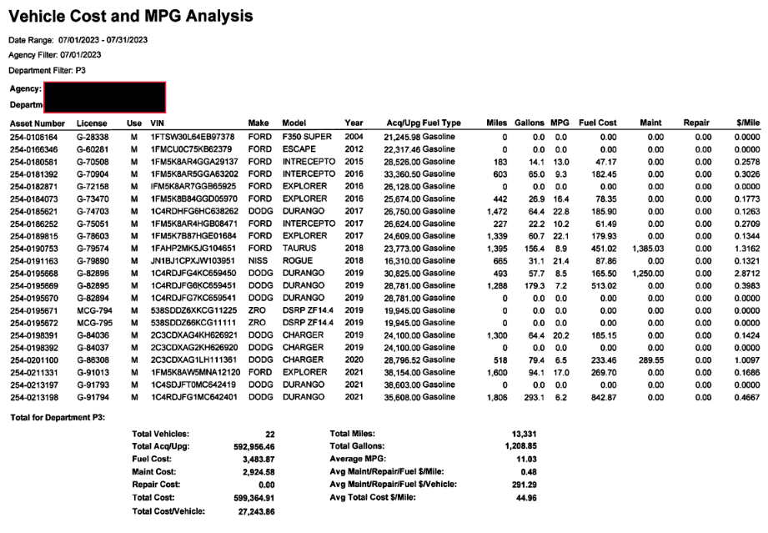

Slide 56
Facilities Management – Hard Key Listings
Preferably in Excel
Complete – All hard keys (including duplicates)
Key #
Description of area for each key
To whom was the key issued
Date of issuance/return
Unissued keys – where are they stored?

Slide 57
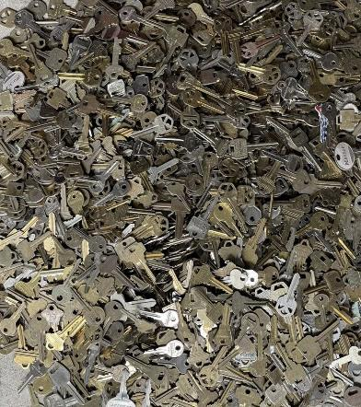
Facilities Management – Hard Key Listings
Too many keys and no idea where to start?
Consider re-keying critical areas

Slide 58
Facilities Management – Electronic Access
Genetec and Total Card
Genetec – Integrated Security Management Division (MSU Police)
Total Card – MSU ITS
Departments are responsible for monitoring access to their building(s)
If someone’s access looks suspicious, don’t assume it’s OK! Verify!
Terminated employees
Employees who transferred to other departments

Slide 59
Information Security
Completion of separating checklists
Departmental software logins / passwords
Physical security
Sensitive physical documents – typically, keep locked, especially in high traffic areas

Slide 60
General Administration
Current desk manuals for critical departmental controls and procedures
Helpful for new employees or backups
Review and update periodically
Whistleblower poster containing EthicsPoint information is posted centrally in the department

Slide 61
THANK YOU!

