Slide 1
Basic Control Assessments and Continuous Monitoring Audits
Presented by Lesia Ervin
Office of Internal Audit
Mississippi State University
www.audit.mssstate.edu
Notes:
Welcome everyone. Today’s session will give you a high-level understanding of internal controls, common fraud red flags, and what we look for during departmental control assessments. The goal isn’t to make you auditors, it’s to help you protect your department and the university.

Slide 2
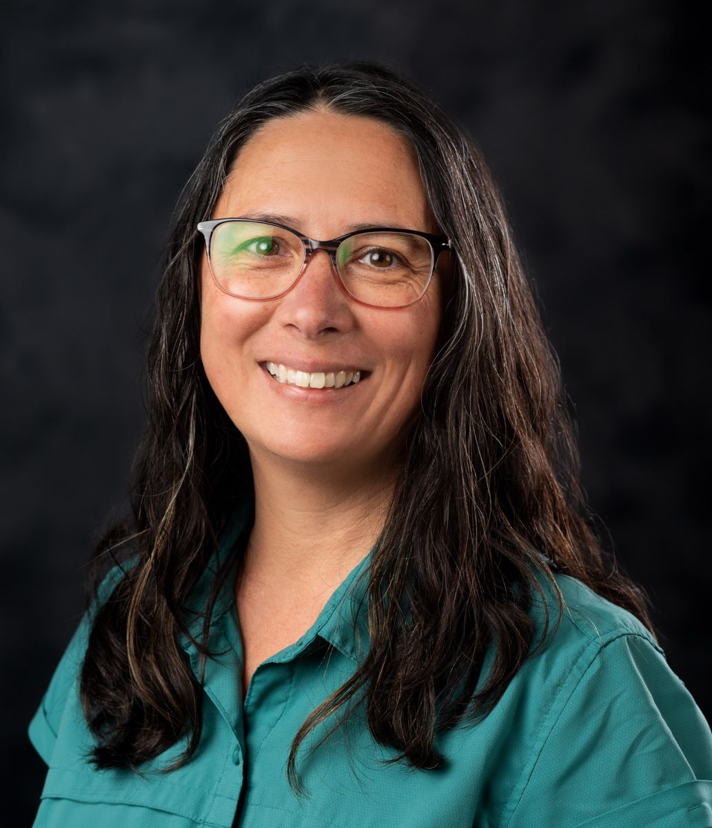
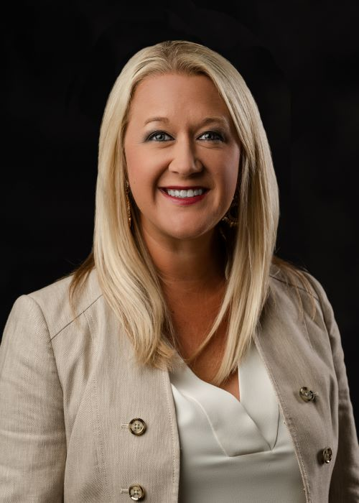
About
Lesia Ervin, Audit Director
MSU graduate
Experience… Over 25 years of audit experience
  MSU Office of Internal Audit
  University of Houston’s Internal Audit
  Arthur Andersen LLP, Houston, TX
Oversees:
  Operational, Compliance, IT, & Departmental Audits
  Investigations of Fraud, Waste, & Abuse
  Management of the University’s Hotline
Jordan Ramsey, Deputy Director
MSU graduate
  Masters of Business Administration
  Dual degrees in International Business
    with emphasis in Business and Spanish
Experience… Over 15 years of audit experience, primarily
  within higher education including serving on several peer
  review teams
Oversees:
  Everything…
Notes:
Welcome everyone. Today’s session will give you a high-level understanding of internal controls, common fraud red flags, and what we look for during departmental control assessments. The goal isn’t to make you auditors, it’s to help you protect your department and the university.

Slide 3

Training Objectives
Preliminaries, overview of Internal Audit and types of audits
Understand internal controls and why they matter
Recognize fraud, waste, and abuse
Identify common red flags
As an added bonus we will show you what Internal Audit reviews in a Basic Control Assessment (BCA)!
Notes:
By the end of this training, you’ll have a clear understanding of your role in maintaining good internal controls and recognizing warning signs before issues arise.

Slide 4
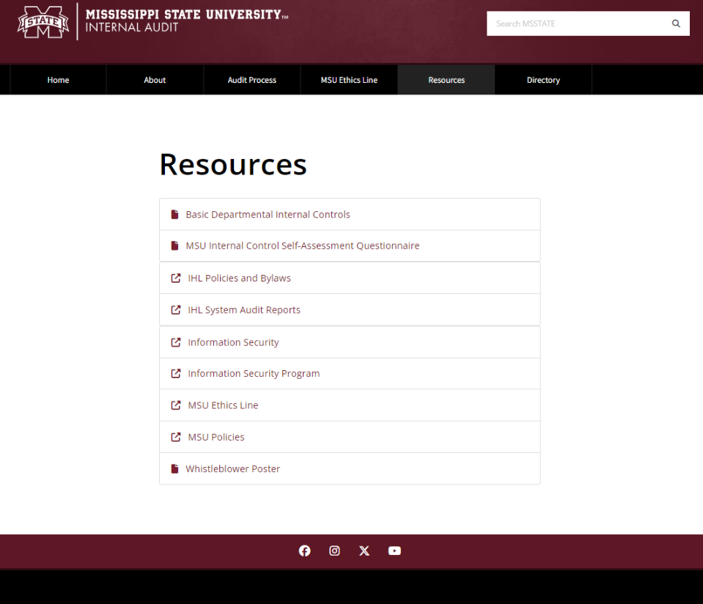
Resources at Internal Audit’s Website www.audit.msstate.edu

Slide 5
Internal Control Self-Assessment Questionnaire
Voluntary
Thorough - 18 pages of information
For fans of checklists
See what you’re missing or haven’t thought about
Areas covered include:
  Procurement
  Travel
  Payroll
  Leave
  Reconciliations
  Revenues / Cash Handling
  Facilities Management
  Equipment / Inventory
  Fleet Management
  Sponsored Research
  And more

Slide 6
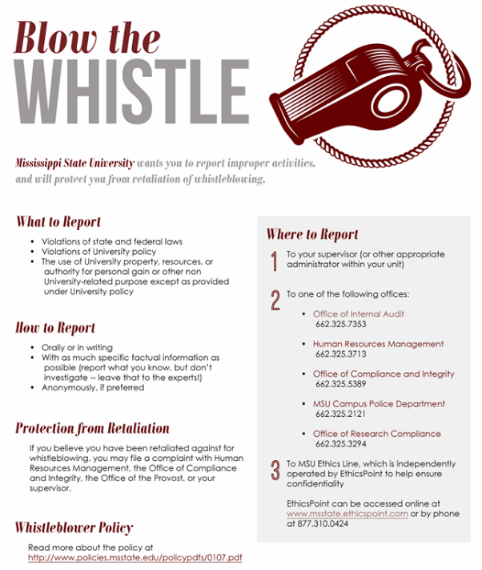
MSU Ethics Line – What It’s For
Must be posted in a visible, accessible location
Provides reporting guidance for:
  Law or policy violations
  Misuse of MSU resources or authority for personal gain
Offers confidential/anonymous reporting
Independently operated; Internal Audit follows up on all reports
Report via: www.msstate.edu/ethics-line/ 877-310-0424

Slide 7
Why Do We Audit?
We identify and evaluate risks
Types of Risks (FROCS)
  Financial
  Reputational
  Operational
  Compliance
  Strategic
Internal controls – are they sufficient to manage risks?

Slide 8
Internal Controls and Why They Matter?
Internal controls - Processes that provide reasonable (not absolute) assurance that objectives are achieved.
Controls protect MSU’s people, property, and reputation
Ensure accuracy and compliance
Weak controls increase risk
Notes:
Internal controls are like seatbelts for operations, they won’t prevent every accident, but they keep us safe. When controls are weak or ignored, we open the door to errors and misconduct.

Slide 9
Why Controls Matter
Control activities are actions supported by policies and procedures to manage risk
PREVENTIVE
Proactive controls to prevent loss
Designed to discourage errors or prevent irregularities from occurring
DETECTIVE
Provide evidence a loss has occurred
Designed to find errors/irregularities after they have occurred
Examples:
Segregation of Duties
Transaction Approvals
Adequate Documentation
Physical Control over Assets
Examples:
Reviews
Reconciliations
Physical Inventories
Analyses or Variance Analyses
Notes:
Internal controls are like seatbelts for operations, they won’t prevent every accident, but they keep us safe. When controls are weak or ignored, we open the door to errors and misconduct.

Slide 10
Common Weaknesses
One person controls entire process
Lack of review or oversight
Late reconciliations
Overreliance on trust
Notes:
Most fraud or control failures happen because duties aren’t properly separated or reviews don’t happen. The phrase ‘trust but verify’ applies here.

Slide 11

Most Common Reason Fraud Occurs
Meet Sally
When one person is given complete control of the financial process without any oversight or monitoring from the supervisor or department head.
Hi, my name is Sally.
I’m in charge of collecting all the registration fees for our department’s summer camps.
I also deposit the cash and checks....
…and reconcile the department accounts….
….and rob you blind in the process.
Notes:
This example is exaggerated, but not by much. When one person controls an entire process without oversight, fraud risk skyrockets. It’s the most common issue we see in audit reviews.

Slide 12
The Risk Landscape: Fraud, Waste, & Abuse
Waste
Abuse
Fraud
Act of using or expending resources carelessly, extravagantly, or to no purpose
Improper behavior or actions that a careful person would not consider reasonable or necessary. This includes using power or position for personal benefit or to help someone else.
Obtaining something of value through willful misrepresentation.
Whether something is considered fraud is decided by the courts or legal systems.
Management has a responsibility for managing the risk of fraud.
Source: Sections 8.02 and 8.03 of “Standards for Internal Control in the Federal Government” (Green Book), Controller General of the United States, Government Accountability Office, GAO-13-704G, September 2014 (http://www.gao.gov/products/GAO-14-704G). Also referenced by the OMB Circular A-123, Management’s Responsibility
Notes:
These three concepts are closely related but distinct. Fraud is intentional; waste and abuse may stem from carelessness or poor judgment. All of them weaken trust and efficiency.

Slide 13
The Risk Landscape: Fraud, Waste, Abuse, & Fraud
Error
Waste
Abuse
Fraud
Characteristic
Good faith effort to follow rules, unintentional mistake
Inefficiency, no personal gain, careless use of resources
Regular self-benefit at MSU’s expense, unethical but not illegal
Deliberate deception, illegal activity
Intent
Earnest attempt
Not malicious, just inefficient
Self-interest, unethical but not illegal
Criminal attempt for personal gain
Business Manager processes an expense to the wrong grant account by mistake.
Admin orders excessive supplies that go unused
Dept Head takes frequent trips to desirable locations with minimal benefit to MSU
Faculty member submits fake travel expenses for a conference they did not attend
Scenario
Notes:
Key Concepts
Error
Unintentional mistake, good faith effort to follow rules
Example: Expense charged to wrong grant account by mistake
Waste
Inefficient use of resources, no personal gain
Example: Ordering excessive supplies that go unused
Abuse
Regular self-benefit at MSU’s expense, unethical but not illegal
Example: Frequent trips to desirable locations with minimal benefit
Fraud
Deliberate deception for personal gain, illegal activity
Example: Submitting fake travel expenses for a conference not attended
Distinguishing Factors
Scenario: What happened?
Intent: Was it deliberate?
Characteristic: Legal vs. unethical vs. careless

Slide 14
Responsibility (Fraud, Waste, & Abuse)
University
Administration
Responsible for establishing and maintaining strong controls to prevent and detect fraud, waste, and abuse while fostering an ethical culture.
University
Employees
Expected to uphold ethics, follow established controls, and report suspected fraud, waste, and abuse to leadership or Internal Audit.
University
Internal Audit
Evaluates the effectiveness of controls to prevent or detect fraud, waste, and abuse. Provides assurance that controls work as intended but does not directly prevent fraud.
IIA Standard 9.1 requires them to assess fraud risk management.
Notes:
Preventing fraud isn’t just Internal Audit’s job, it’s everyone’s. We each play a part in protecting the institution’s assets and reputation.

Slide 15
The Fraud Triangle
Pressure: Financial or personal stress
  Living beyond means or facing financial hardship
  Personal crises or costly habits (divorce, gambling, drugs, etc.).
Opportunity: The ability to commit fraud
  Ineffective controls or poor oversight
  Lack of reconciliations or management review
  Belief they won’t be caught
Rationalization: “I’ll pay it back”
  Justifies actions to help loved ones or “borrow” temporarily
  Feels trapped or believes the organization “owes them”
Rationalization
This is the component you have control over!!!
Opportunity
Pressure
Notes:
When these three elements exist together, fraud becomes more likely. Our job as administrators is to reduce opportunity, the one factor we can control.

Slide 16

Documentation Red Flags
Warning signs that may signal fraud risk is higher; they are NOT evidence that fraud is actually occurring
Missing or Incomplete Documentation
  Example: A professor submits a travel reimbursement form without attaching any receipts or providing specific dates of the trip.
  Red Flag: The missing documentation may indicate that the trip did not occur or that personal expenses are being passed off as business-related.
Altered or Unusual Documents
  Example: A business manager notices that an invoice for lab equipment has handwritten changes to the amounts, or there are multiple fonts in the same document.
  Red Flag: This suggests the invoice might have been altered to inflate the costs or change payment details for personal gain.
Duplicate or Fictitious Entries
  Example: A university department submits two identical reimbursement requests for the same conference registration fee.
  Red Flag: Duplicate requests may indicate an attempt to receive payment twice for the same expense.
Notes:
Red flags don’t always mean fraud, but they signal increased risk. Stay alert for unusual documentation or repetitive patterns that don’t make sense.

Slide 17
Documentation Red Flags
Warning signs that may signal fraud risk is higher; they are NOT evidence that fraud is actually occurring 2
Unexplained Adjustments or Reconciliations
  Example: Financial records show large, unexplained journal entries marked as “miscellaneous adjustments” to a research grant without backup documentation.
  Red Flag: This may be an attempt to reallocate grant funds improperly or hide misused funds.
Discrepancies Between Supporting Documents
  Example: A department submits a catering invoice for a faculty event, but the event calendar and attendance records show that the event never took place.
  Red Flag: The mismatch between the submitted invoice and the event records suggests the claim may be fraudulent or involve misappropriation of funds.
Unusually High Transactions or Round Numbers
  Example: A department consistently places orders for exactly $4,999, just below the threshold for requiring additional administrative approval.
  Red Flag: Regular round-number transactions at this level could indicate efforts to avoid proper oversight or inflated costs.
Vendor or Employee Relationships
  Example: A facilities manager repeatedly contracts a personal friend’s company for building repairs, bypassing the university’s bidding process.
  Red Flag: Close relationships with vendors without proper bidding could indicate conflicts of interest or kickbacks.
Notes:
Red flags don’t always mean fraud, but they signal increased risk. Stay alert for unusual documentation or repetitive patterns that don’t make sense.

Slide 18
Fraud & Ethics Events in Higher Education
9/15/25– Ethics - A University of Kentucky equine testing lab was found to have falsified test results related to banned substances. The university later terminated the lab’s director following the investigation.
3/1/25 – Occupational Fraud - A UConn faculty member was charged with using university and grant funds for personal travel, including trips to Ireland and Disney World, in violation of policy.
7/16/24 – False Claims Act - The University of Maryland paid $500,000 to settle claims it failed to disclose foreign funding support on federal research grant proposals between 2015 and 2020.
7/2/24 – Cronyism - At Utah State University Eastern, an employee was paid for two years without working while administrators, friends of the staffer, covered for him, according to a university audit.
9/17/24 – Occupational Fraud - Dartmouth College’s student newspaper office manager sentenced to 15 months for stealing over $223K across four years.
9/5/24 – Occupational Fraud - A University of Iowa employee allegedly diverted nearly $1M by using university equipment and staff for personal business.
8/12/24– Ethics - Former University of Florida president Ben Sasse tripled office spending in 17 months, awarding secretive consulting contracts and high-paying roles to political allies.
7/16/24 – False Claims Act - University of Maryland paid $500K to settle claims it failed to disclose foreign funding support on federal research proposals.
7/2/24 – Cronyism - Audit at Utah State University Eastern found an employee was paid for two years without working while supervisors looked the other way.
6/18/24 – Occupational Fraud - Webster University’s former IT director admitted to a multimillion-dollar fraud scheme involving the university and a technology vendor.
Notes:
These are real, recent cases from universities. They all share common threads: lack of oversight, weak reconciliation, or failure to follow policy. These cases can happen anywhere, controls make the difference.

Slide 19
Types of Internal Audits at MSU
Basic Control Assessment
Process Audit
Continuous Audit
Investigation
Follow-up

Slide 20
Continuous Monitoring Audits - Overview
Limited Scope – each audit focuses on one area
  Account Reconciliations
  Separation Checklists
  Safety Reviews
  Additional areas will be added (e.g., payroll, research)
Samples pulled across multiple departments/units
Typically unannounced
Reports addressed to Dr. Keenum; VPs & deans copied
No formal follow-ups, but areas with issues may be selected more frequently or for a full audit
Goal: maximize coverage across the University
Reinforces a culture of detection and accountability

Slide 21
Basic Control Assessment (BCA) Overview
Internal Audit’s review of key departmental controls
Goal: Confirm processes protect assets
BCA Areas
Account Reconciliations
Leave
Records of Hours Worked
Compensatory Time Balances
Cash
Procurement Card
Property Management
Fleet Management
Facilities Management
Sponsored Research
Information Security
Travel
General Administration
Notes:
The Basic Control Assessment, or BCA, is how we assess whether your department’s controls are working as intended. Think of it as a wellness check, not a test.
We look at the foundational areas that keep operations sound. The focus is on documentation, segregation of duties, and timely review.

Slide 22
Account Reconciliations
What we look at: Ledger reports (FWREXEG/FWREXDP)
What we look for: Signed, dated, monthly reviews
University Policy: 61.01, Account Reconciliation
  Controls and Good Practices
  A formal reconciliation of revenues and expenditures should be performed monthly
  Reconciliations should be performed timely for all active accounts
  Signed by Preparer and Reviewer
  Reviews of account reconciliation should be performed by the Department Head (DH) or Principal Investigator (PI) to ensure accuracy
  Treat the ledger report like a bank statement
Notes:
Account reconciliations are your first line of defense. Always sign and date reviews, and question anything that looks off or unfamiliar.

Slide 23
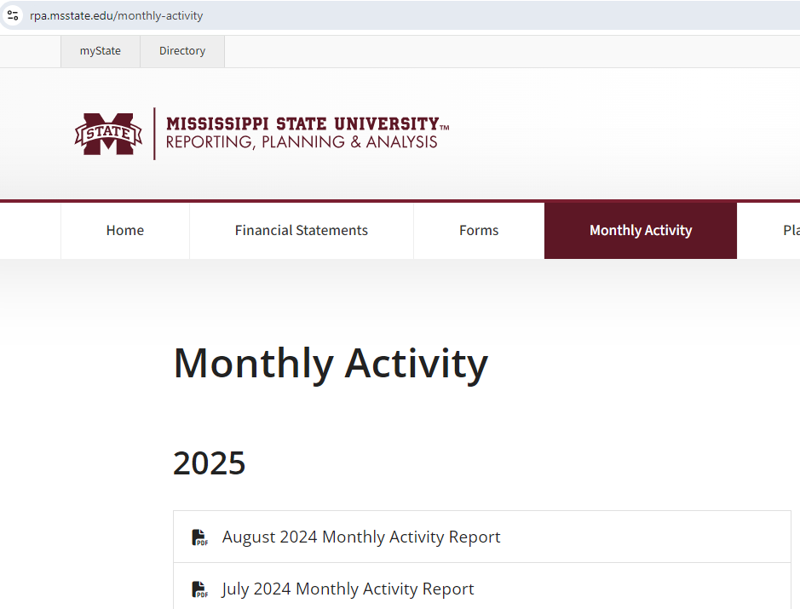
How do I know what needs to be reconciled?

Slide 24
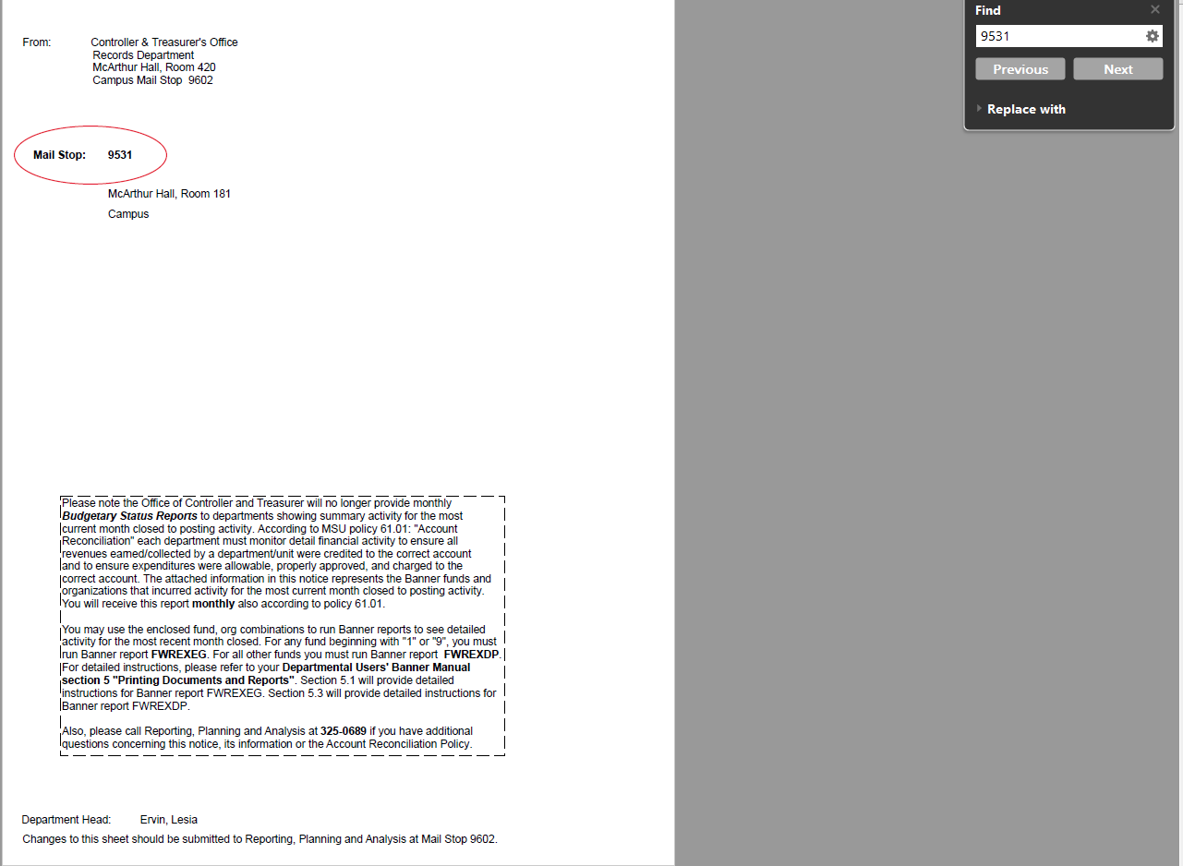
Account Reconciliations – Monthly Activity Report

Slide 25
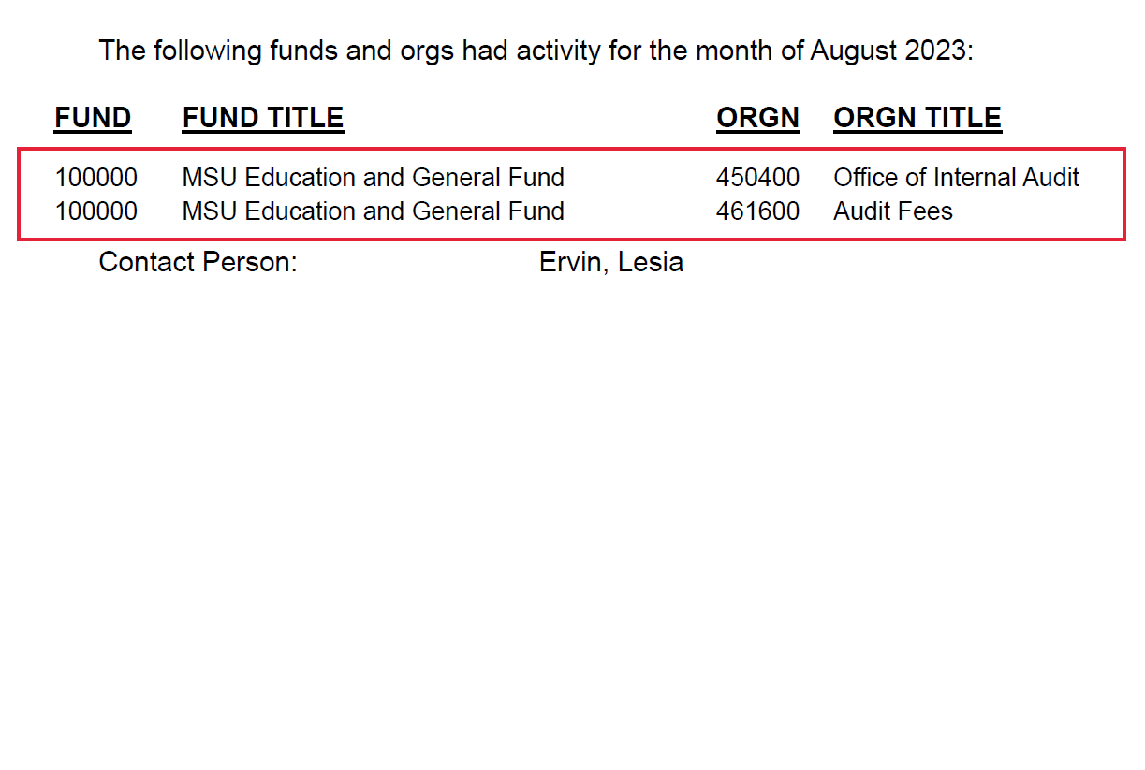
Account Reconciliations – Monthly Activity Report with Activity

Slide 26
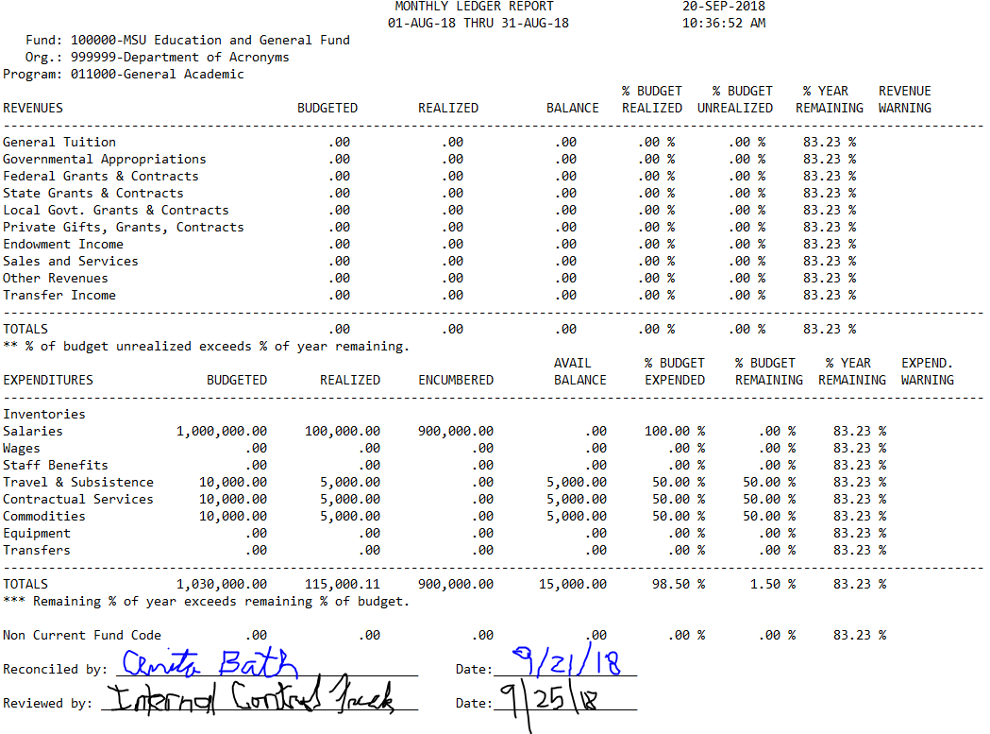
FWREXEG: Monthly Ledger Report
Signed by reconciler
Signed by reviewer (Dept. Head or PI for grants)
Timely

Slide 27
Separating Checklists
Required by MSU Policy 60.405
Departments must complete and maintain the Separating Procedure Checklist when:
    Employee terminates
    Employee transfers
Primary purpose: Removal of access (buildings, keys, sensitive information, software)
Signed by preparer
Should be completed ASAP, preferably at time of termination or transfer

Slide 28
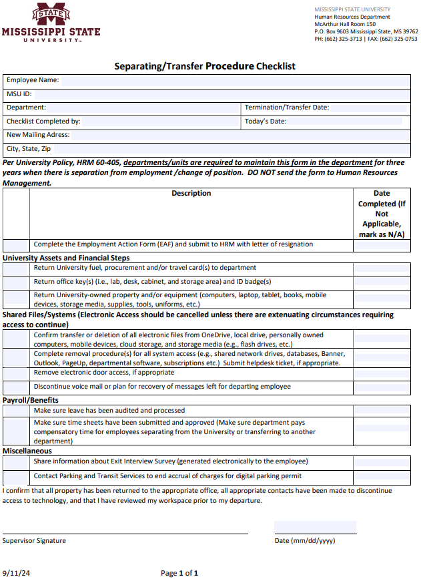
Separating Checklists Form

Slide 29
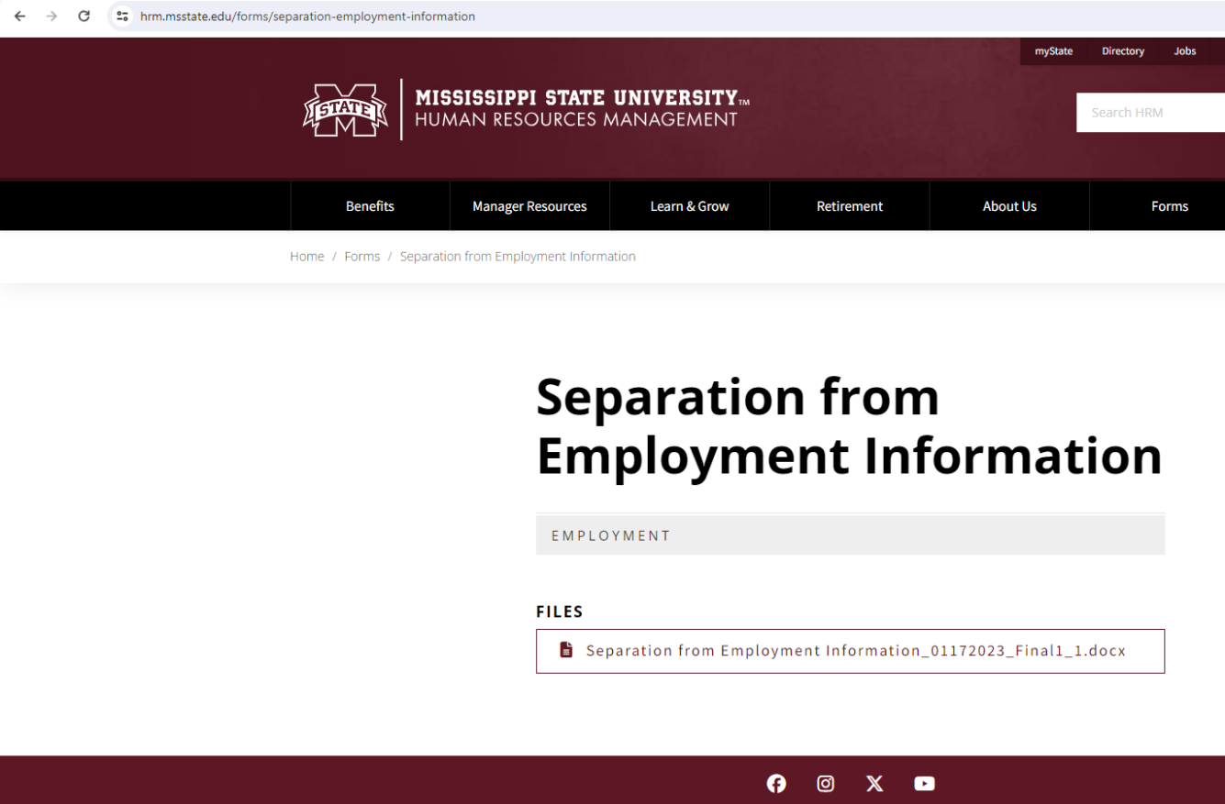
Separating Checklists Website

Slide 30
Leave Reporting
What we look at: PWRLVEF and PWRLVNF reports
What we look for: Timely, signed monthly reconciliations
University Policy: 60.201, Leave/Leave Without Pay
  Controls and Good Practices
  All eligible employees should be reporting leave usage
  The authorization or taking of leave without the completion and submission of appropriate leave forms is considered a misuse of assets (Policy 01.19) and subject to disciplinary actions
  Documentation should exist to support that leave usage and balances are reconciled timely
  Errors in leave are found in most of our control assessments
Notes:
Leave errors are common. Reconciliations ensure records reflect reality and prevent misuse of time or pay.

Slide 31
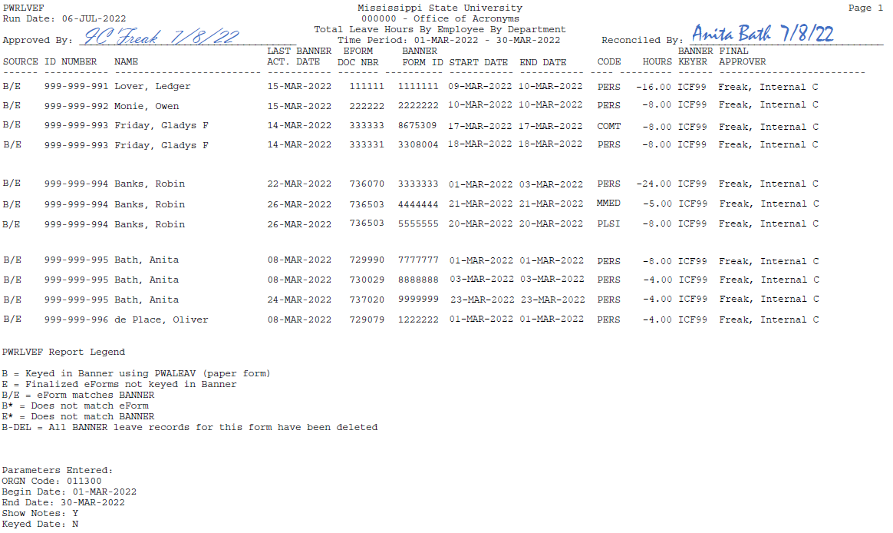
PWRLVEF: Banner/eForm Leave Reconciliation
Timely?
Signed by the reconciler
Signed by reviewer (DH)
This recon was not performed timely.
(i.e. this would be a finding!)

Slide 32
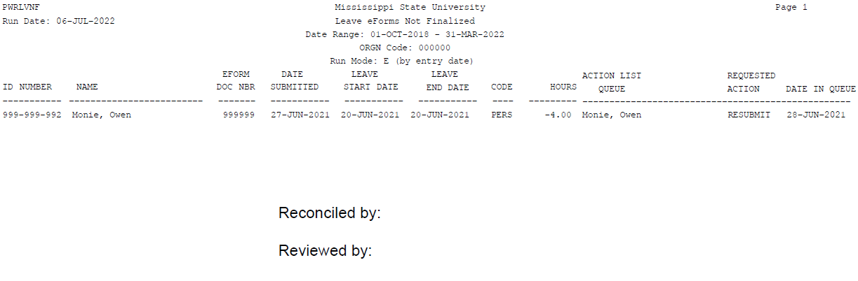


PWRLVNF: Leave eForms Not Finalized
This recon was not performed timely.
(i.e. this would be a finding!)
Note: This a 2-part report.
1st Part (or page) shows leave eForms not finalized (which means the eForm is in someone’s queue, but not processed). Use this page of the report to follow up on any old eForms still in an action queue.

Slide 33
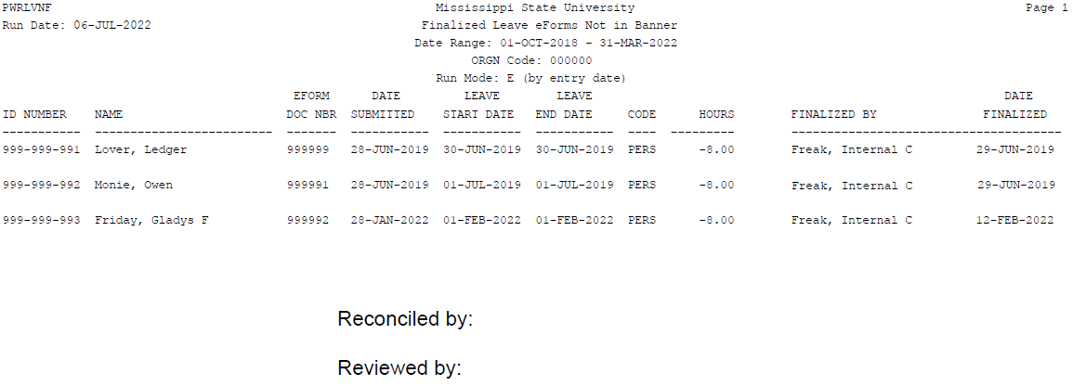


PWRLVNF: Finalized Leave eForms Not in Banner
This recon was not performed timely.
(i.e. this would be a finding!)
Note: This a 2-part report.
2nd Part (or page) shows finalized leave eForms not in Banner (has not been uploaded into Banner yet). Use this page of the report to follow up on any eForms finalized but not uploaded into Banner.

Slide 34

Payroll/Hours Worked
What we look at: Timesheets, PWRVOCC/PWRVOCH
What we look for: Timesheets signed & dated, proper review
60.109, Records Management & Security
60.311, Overtime/Compensatory Time
60.320, Office Hours/Work Schedule
  Controls and Good Practices
  Timesheets are maintained by the department for all non-exempt employees (based on federal/state law)
  DH/administrator should sign off on the Banner Payroll Voucher (PWRVOCC)
  Proper segregation of duties
  Timesheets signed by supervisor and employee ON OR AFTER last day worked
  Timesheets should not be given back to employees to turn in
  When reviewing the PWRVOCC, the Unit Head should look for:
    Any unknown employees (ghost employees) or employees who have been terminated
    Any unusual overtime, other, or special pay
Notes:
Verifying hours worked protects employees and departments. It’s also where we catch ghost employees or improper pay.

Slide 35
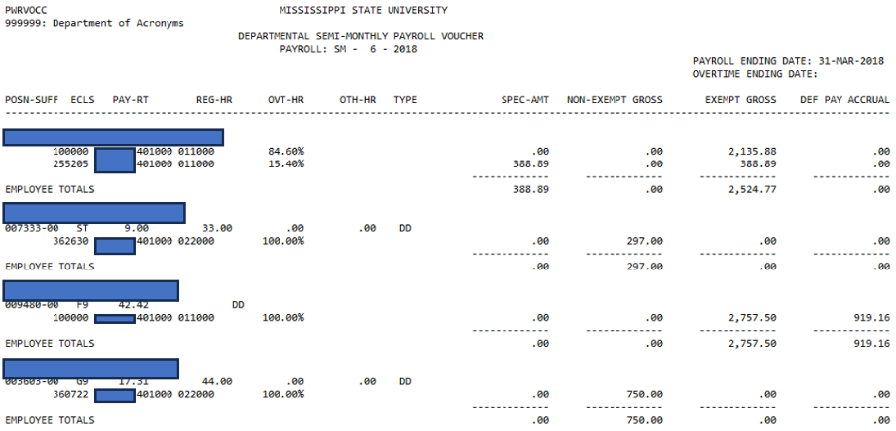
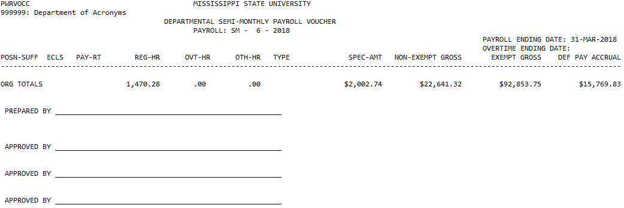


PWRVOCC: Payroll Voucher
Note: Documentation exists to support the Payroll Voucher is reviewed by the Department Head or designee

Slide 36
Compensatory Time
What we look at: Departmental Leave Summary (PWRLDPT), timesheets
What we look for: Recorded and reviewed in Banner
60.109, Records Management & Security
60.311, Overtime/Compensatory Time
60.320, Office Hours/Work Schedule
  Controls and Good Practices
  Compensatory time (comp time) should be reconciled by one individual
  Comp balances/reconciliation should be reviewed by the DH
  Comp time liability is held by the department in which the balance was accrued.
    This balance must be paid by the department when the employee transfers to another unit/dept or is terminated.
  Make sure employees use comp time before using personal leave
  Maintain compensatory time in Banner (key accrued and taken in Banner similar to the leave process) as required by policy
Notes:
Departments carry the liability for comp time. If it’s not tracked accurately, it becomes a financial and compliance risk.

Slide 37

Cash Handling
What we look at: Cash logs, deposits, support docs
What we look for: Timely deposits, secure storage, segregation
62.07, Cash Handling
  Controls and Good Practices
  Cash is defined as coin, currency, checks, money orders and credit card transactions
  Because of the liquid nature of cash, it is highly scrutinized
  Separation of duties: if possible, separate the components of cash handling (collecting, depositing, and reconciling). In small departments separate the handling of the actual cash from the reconciliation
  Reconcile from cash receipts to record in Banner during monthly reconciliation
  Use pre-numbered receipts and/or a cash log
  Timely deposits (weekly or when balance reaches $1,000)
  Secure cash in a safe location
Notes:
Cash is always high risk. Even small balances should be logged, deposited quickly, and stored securely.

Slide 38

Procurement Card (ProCard)
What we look at: Regions statement, ProCard log, Card Integrity Report
What we look for: Signed & dated statements, secure storage, bid law compliance
Procurement Card User’s Guide
  Controls and Good Practices
  Ensure compliance with state laws
    Watch out for split purchases
  DH should review transactions & sign the actual Regions ProCard statement
  When multiple employees use a ProCard, a log should be used to track user name, date, check-in/out times, location of use, amount, purpose, etc.
  Document purpose of unusual purchases
Notes:
Ask about transactions, even if they seem routine. The simple act of asking shows oversight and helps spot irregularities.

Slide 39
Property Management
What we look at: Annual self-audits, hand receipts
What we look for: Assets accounted for, updated yearly
Property Management Manual
  Controls and Good Practices
  Annual Self Audit - should be performed by someone other than, or in addition to, the inventory representative
  Hand receipts - must be used for the removal of property off campus & updated annually
  Should be able to produce the asset or a hand receipt at all times
  We recommend that a hand receipt be completed for any portable assets (such as laptops) assigned to an employee
  Hand receipts should be:
    completed in their entirety
    assets visually inspected
    signed by the inventory representative
    done one time per year (i.e. every July)
Notes:
Portable assets like laptops are easy to lose. Regular check-ins and hand receipts reduce loss and improve accountability.

Slide 40

Fleet Management
What we look at: Vehicle logs, Fuelman statements, Recoup Reports
What we look for: Complete logs, secured fuel cards, unique PINs
Fleet Management Guidelines & Procedures Manual
  Controls and Good Practices
  A vehicle log for each vehicle should be used to document every trip in a University vehicle (except for in and around campus trips)
  ReCoup (Assetworks) MPG report should be run monthly
    Signed by Department Head (or designee)
    NOT a formality; should be scrutinized
  Have a process for adding and removing individuals to the fuel card system
  Each driver of a MSU vehicle should have their own PIN; employees should not share PINs
Notes:
Fleet misuse adds up quickly. Look for fuel amounts that exceed tank capacity or miles per gallon that don’t make sense.

Slide 41
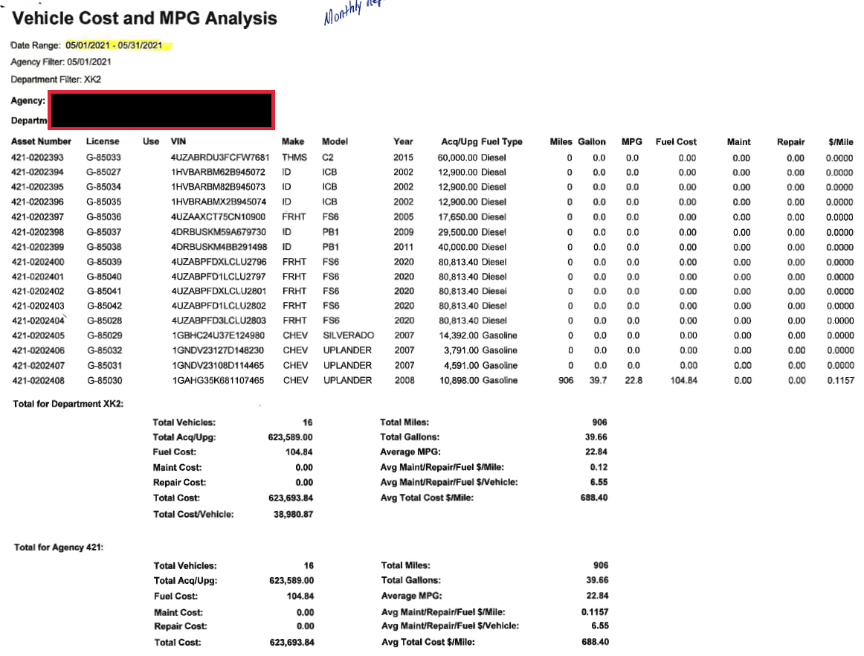
Vehicle Cost & MPG Analysis Report

Slide 42
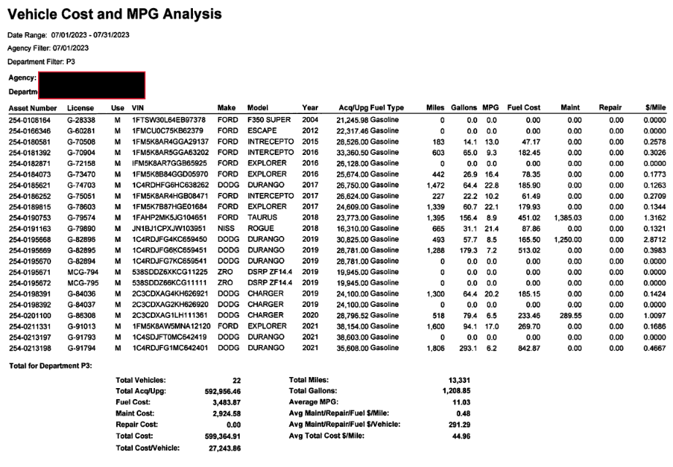
Vehicle Cost & MPG Analysis Problem Report

Slide 43
Facilities Management -Keys
What we look at: Key listings, check-in/out process
What we look for: Keys secured, access lists updated, record of keys
91.354, Facilities Use
01.10, Information Security
  Controls and Good Practices
  Maintain an accurate record of issued and unissued keys and periodic analysis of missing keys to ensure adequate security
    When was the last time your office, suite, or building was keyed/rekeyed?
    Key Listing:
      Preferably in Excel,
      Complete – All hard keys (including duplicates),
      Key #, Description of area for each key,
      To whom was the key issued,
      Date of issuance/return,
      Unissued keys – where are they stored?
Notes:
Facilities access is often overlooked. Lost or untracked keys create real security risks. Review access lists and key lists regularly and clean them up at least once a year.

Slide 44
Facilities Management – Electronic Access
What we look at: Key listings, check-in/out process
What we look for: Keys secured, access lists updated, record of keys
91.354, Facilities Use
01.10, Information Security
  Controls and Good Practices
  Genetec and Total Card
  Genetec – Integrated Security Management Division (MSU Police)
  Total Card – MSU ITS
  Departments are responsible for monitoring access to their building(s)
  If someone’s access looks suspicious, don’t assume it’s OK! Verify!
  Terminated employees
  Employees who transferred to other departments
Notes:
Facilities access is often overlooked. Lost or untracked keys create real security risks. Review access lists and key lists regularly and clean them up at least once a year.

Slide 45
Sponsored Research
What we look at: Confirmation of Effort reports
What we look for: Timely, verified submissions, who signs reports
70.08, Time and Effort Reporting
  Controls and Good Practices
  Timely and accurate completion of Confirmation of Effort reports by someone with suitable means of verification that the work was performed
  Business Managers should not be signing individual effort reports
  Most common finding is failure to submit reports timely
  Make sure your employees understand what they are signing

Slide 46
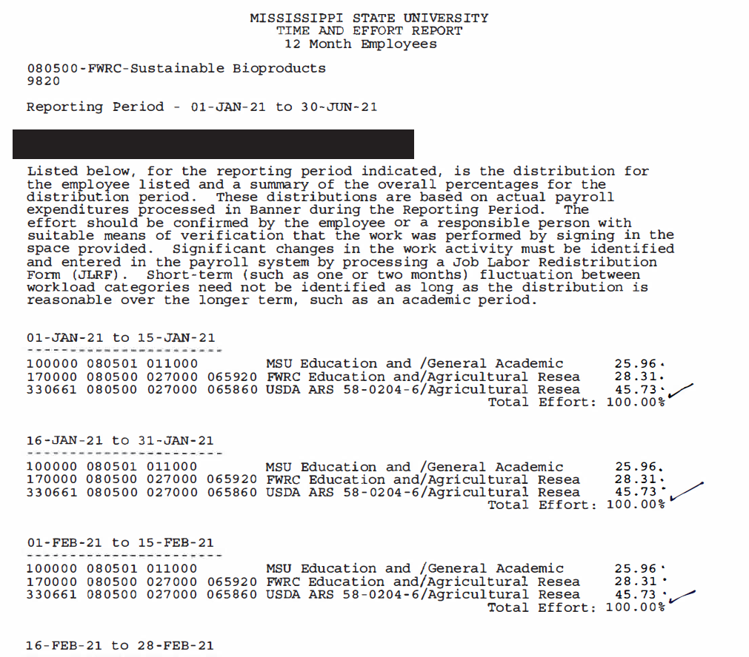
Research – Time and Effort Reports

Slide 47
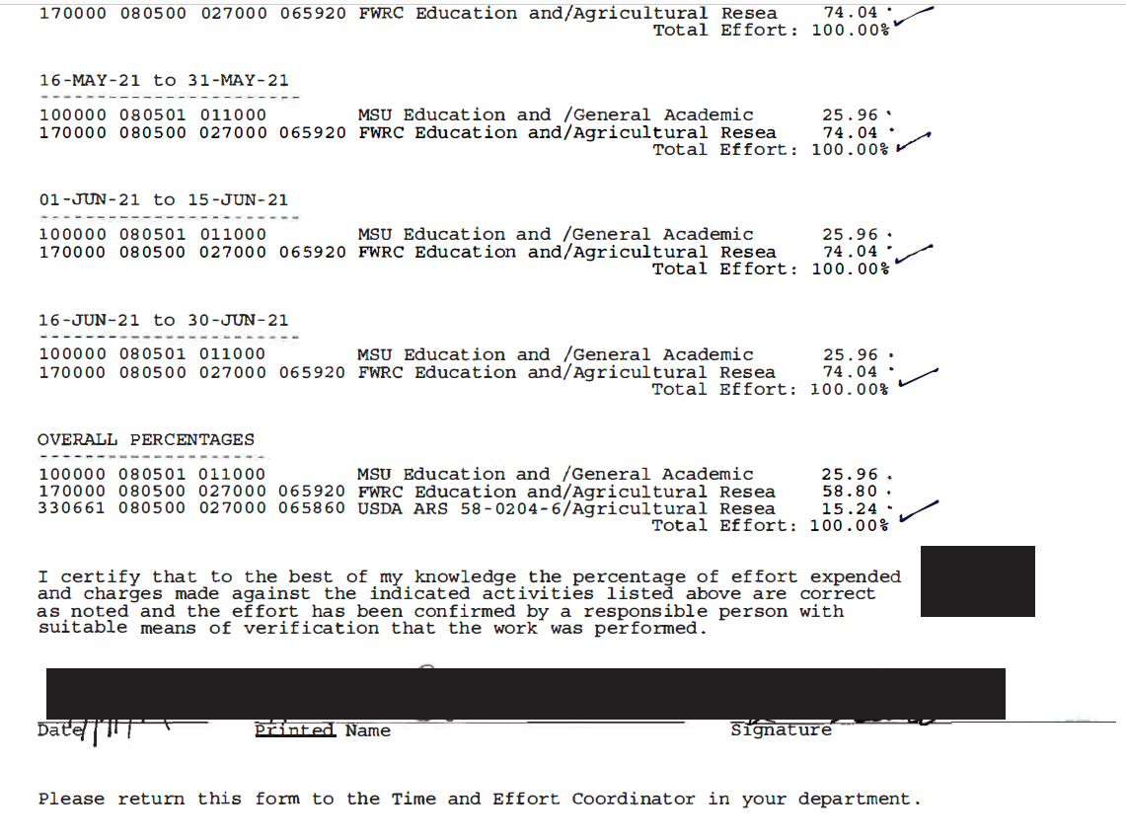
Research – Time and Effort Reports
Signature Page

Slide 48
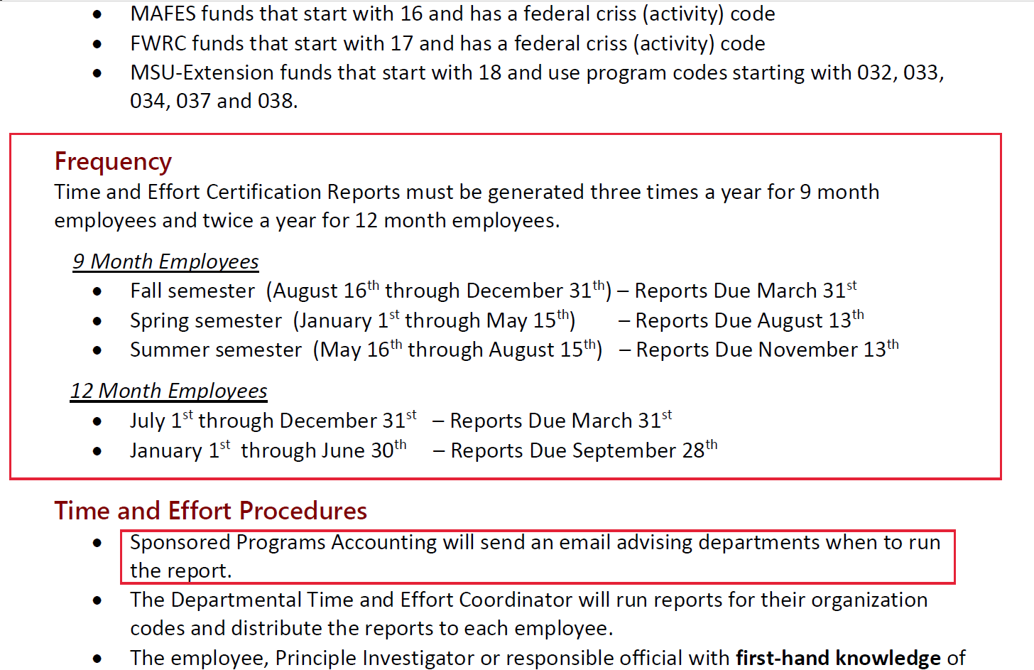
Research – Time and Effort Reports
Instructions

Slide 49
Information Security
What we look at: Data security, Banner access, Termination checklist
What we look for: Separating checklists for all employees who terminate or transfer
01.10, Information Security
01.11, Policy on Access to IT Resources
01.12, Use of IT Resources
01.23, Social Security Number Usage
60.405, Separation of Employment/Change of Position
  Controls and Good Practices
  Sensitive information is secured, such as: SSN, financial, personnel/HR records, student records, research data
  Departmental policy should require password protection on computers and encryption software on portable devices (i.e. laptops, flash drives)
  Completion of separating checklists
  Separated employees and students no longer have access
Notes:
Data security is everyone’s responsibility. One unlocked laptop or outdated access list can cause serious exposure. All terminated employees should be completing separation checklist, including SW and GA

Slide 50
General Administration
What we look at: Desk manuals, EthicsPoint poster
What we look for: Up-to-date manuals and visible posters
Best Practice
  Controls and Good Practices
  Desk manual details critical procedures in the event of hiring a new employee or temporary worker substituting for an absent employee
    Review and update periodically
  Display the Whistleblower Poster prominently in a public area with EthicsPoint reporting information so it’s visible to everyone in the building
Notes:
Desk manuals help continuity when someone leaves or is absent. Having clear documentation makes transitions smooth and reduces risk.

Slide 51
Questions & Contact
Lesia Ervin, Director, Office of Internal Audit
Contact info is on our website: www.audit.msstate.edu
Notes:
Thank you for your time and attention. I’m always happy to answer questions or provide guidance if you’re unsure about a process or potential red flag.

